Slide 1
A 100% renewable UK with a focus on heat
Presented by Mark Barrett
Research by Tiziano Gallo Cassarino, Mark Barrett
UCL Energy Institute: EnergySpaceTime group
Run presentation to see animations

Slide 2
Introduction
UCL Energy Institute: EnergySpaceTime group
Aim: design zero greenhouse gas emission UK energy systems with a focus on heat
Test whether designs work in engineering terms, and determine costs
Nine systems are designed with different:
building efficiencies
shares of heating with consumer heat pumps, district heating and electrolytic hydrogen
capacities of renewables, stores and interconnectors
The ESTIMO model (Energy Space Time Integrated Model Optimiser) is used to simulate the systems hourly as driven by 35 years of historic meteorology, and with adjustment for climate change
2
Notes:
Mark

Slide 3



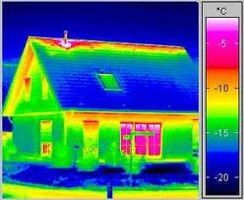

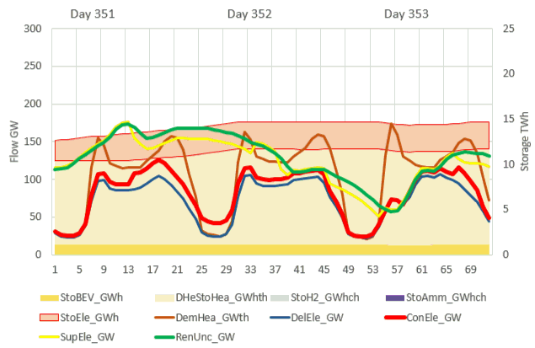
Varying demands and generation - storage, transmission

Slide 4
Energy service demands - the starting point
UCL Energy Institute: EnergySpaceTime group
Energy service demand is the minimum energy required to perform a task
Domestic, services, industry, transport sectors
Eight energy services modelled: space heat/cool, other heat, lighting, equipment, cooking, refrigeration, transport.
All service demands are driven by hourly social use patterns for each sector and end use
Weather independent demands only vary with use patterns
Weather dependent space heating and cooling depend on:
use pattern
ambient temperature and solar radiation
internal temperature of the building or vehicle, heat loss factor of building/vehicle, and heat gains from people, appliances and solar radiation
4
Notes:
Mark

Slide 5
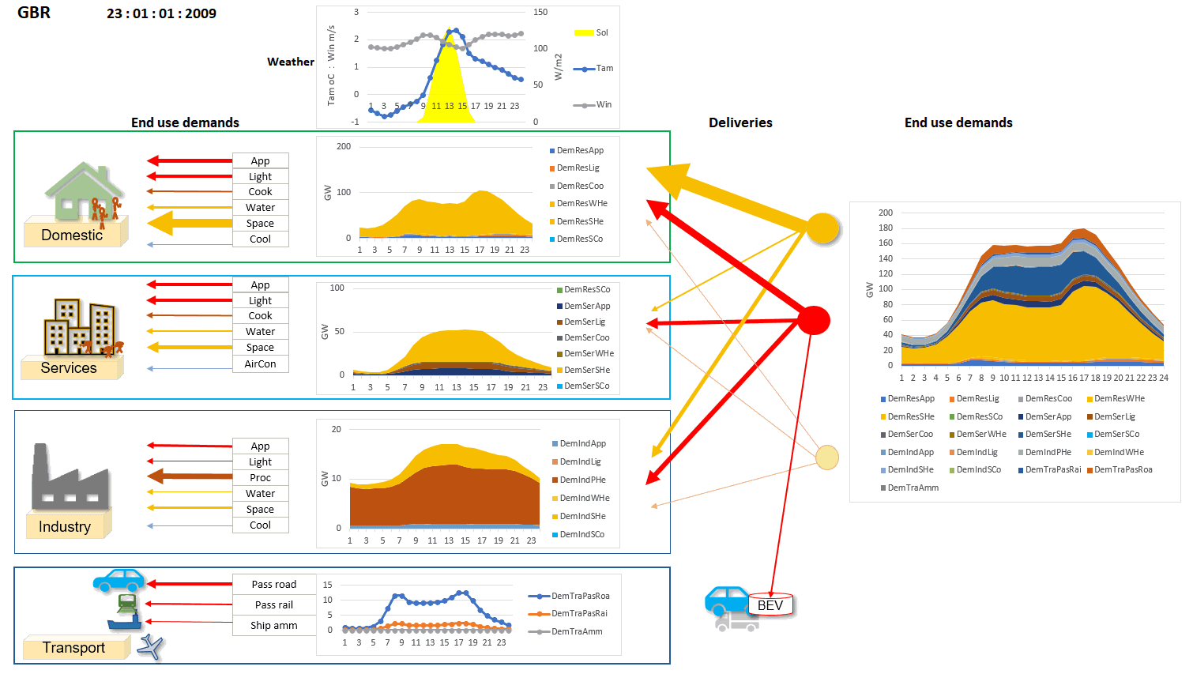
UCL Energy Institute: EnergySpaceTime group
ESTIMO – winter day’s service demands and deliveries
Each end use is simulated hourly, as driven by:
socioeconomic activity patterns
weather affecting heating, cooling, and lighting loads in buildings and vehicles
5
Notes:
Mark

Slide 6
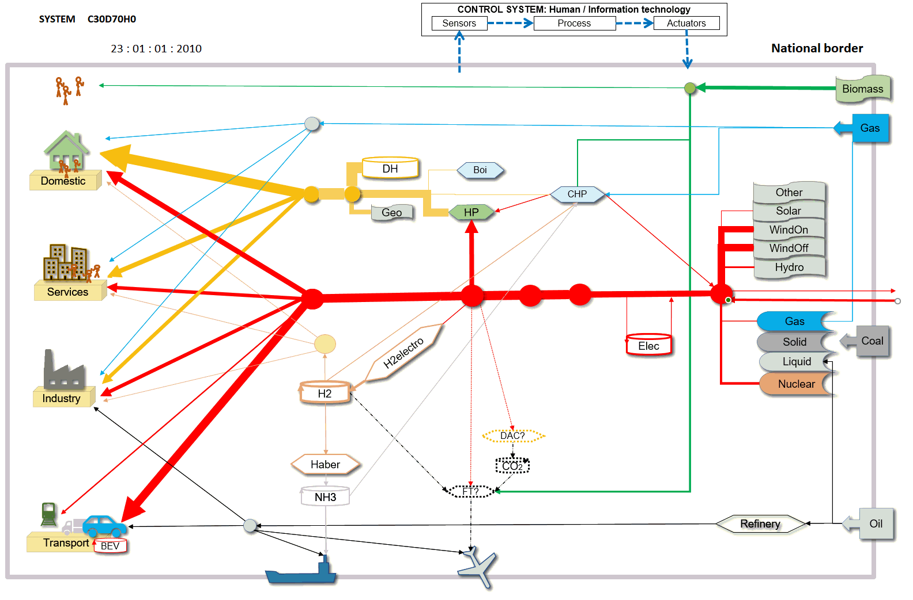
A national energy system
UCL Energy Institute: EnergySpaceTime group
A national energy system comprises three parts:
Demands
Intermediate conversion and storage
Primary and trade
ESTIMO models the energy flows hourly (across the days, months and years) as driven by social activities and meteorology.
ESTIMO dynamically controls the intermediate system, storage and trade
Demands Intermediate transmission, conversion, storage Primary & Trade
Notes:
Mark

Slide 7
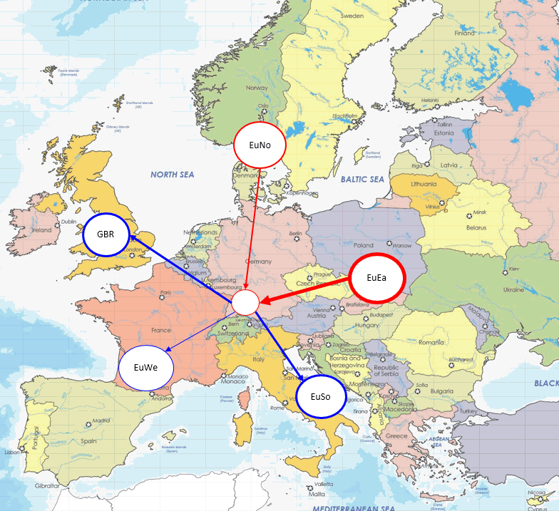
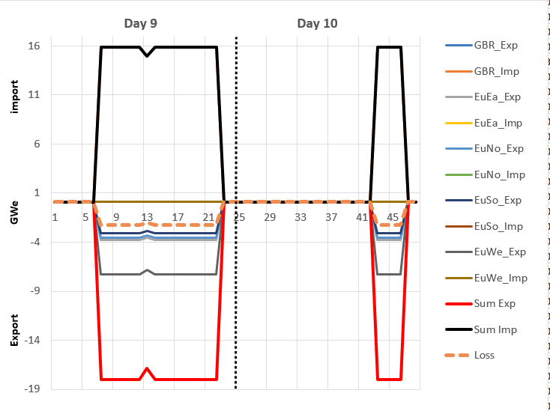
Interconnector trade
UCL Energy Institute: EnergySpaceTime group
ESTIMO simulates:
Energy systems at different nodes with different simultaneous:
Demands because of local weather and time zone differences
Renewable supply because of local meteorology
Interconnector transmission trade of renewable surpluses and deficits at different nodes, reducing storage need by up to 30%.
7
Notes:
Mark

Slide 8
ESTIMO – system control algorithm
UCL Energy Institute: EnergySpaceTime group
The Global Optimal Dispatch (GOD) algorithm in ESTIMO operates the system so as to minimise fossil fuel use. The algorithm is an engineering proof of concept for a dynamic energy market
The basic algorithm comprises three phases:
A. Each node – try to meet demand locally and store any surplus
Calculate demands, and uncontrollable (no storage) renewable and inflexible nuclear generation
Try to meet all demands with uncontrollable generation, and then stores
Try to absorb surplus with stores
B. All nodes: trade surpluses and deficits via transmission
From nodes with surplus uncontrollable to nodes with deficits
From nodes with surplus storage to nodes with deficits
From nodes with surplus uncontrollable to nodes with spare storage capacity
C. Each node– use stored fuel if still remaining demand
If remaining electricity demand and spare heat storage, run DH CHP using electrofuel/biofuel/natural gas
If remaining heat demand run DH CHP, store surplus electricity if possible
If remaining heat demand run DH natural gas boilers
If remaining electricity demand run dispatchable electricity only plant using natural gas
8
Notes:
Mark

Slide 9
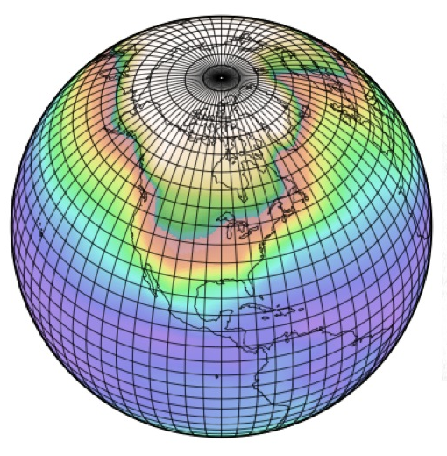
UCL Energy Institute: EnergySpaceTime group
Meteorology
Decades of MERRA global hourly data at 0.5 degree Lat/Lon resolution available.
Data used: temperature, wind, solar
Temperature and solar weighted by population distribution for demand and solar PV modelling
Wind speeds at wind farm locations for generation modelling
This data collation and modelling by Dr Ed Sharp
9
Notes:
Mark

Slide 10
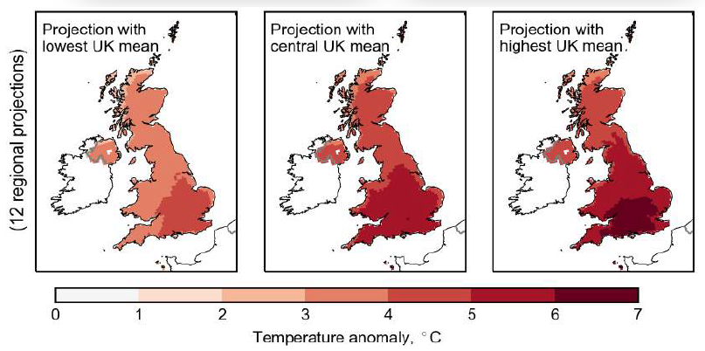
UCL Energy Institute: EnergySpaceTime group
UK climate projection for late 21st century
UKCP18 National Climate Projections. MetOffice, 2018
“A greater chance of warmer, wetter winters and hotter, drier summers long with an increase in the frequency and intensity of extremes.” (high emission scenario: summer +0.9-5.4°C summer, winter +0.7-4.2°C)
Consequences for comfort, heating and cooling and renewables?
Variability in rainfall is increasing:
What impact on hydro, biomass etc?
Notes:
Mark

Slide 11
Heat demand and emissions
UCL Energy Institute: EnergySpaceTime group
We can estimate heat emitted from boilers etc. But this is not service, as not all emitted heat is useful. We want comfort not heated buildings.
Heat accounts for about half of UK energy CO2 emissions.
Future heat demand will be affected by population and economic growth, efficiency (insulation) and climate change.
Personal Comfort Services (heated furniture etc.) might radically affect space heat demand.
Notes:
Mark

Slide 12
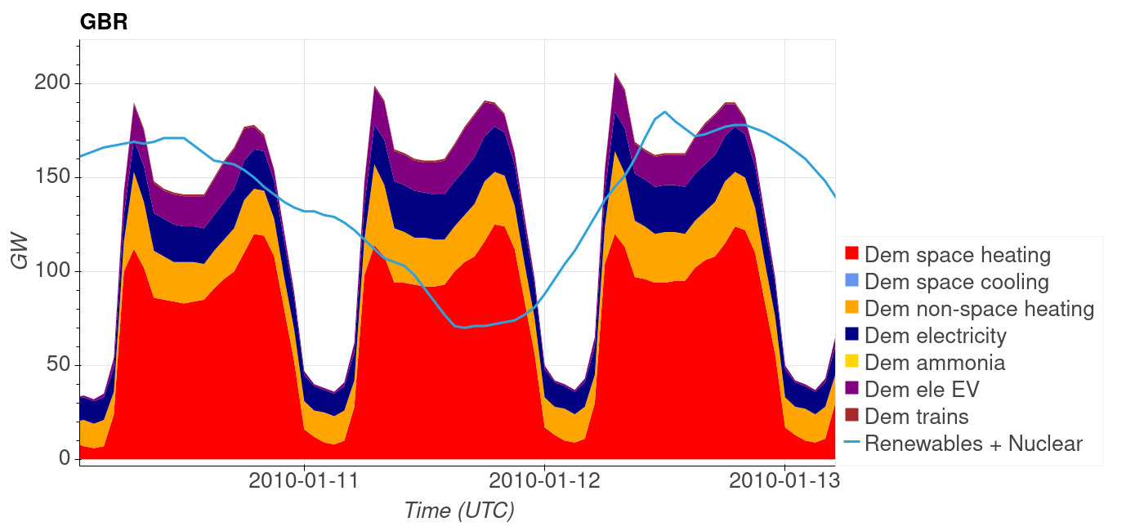
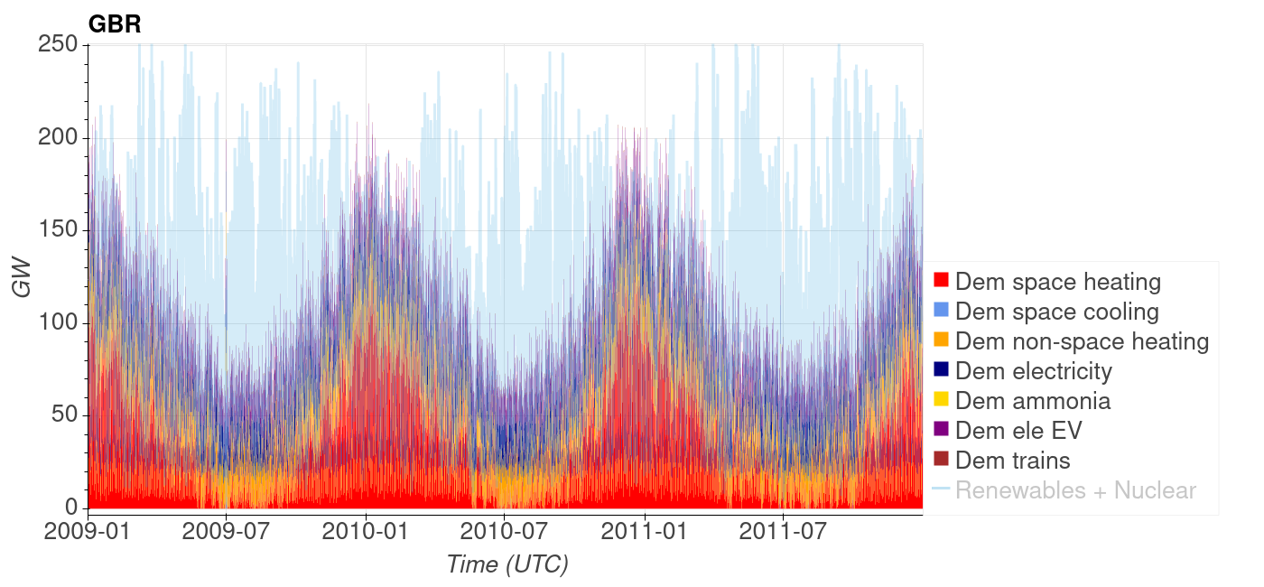
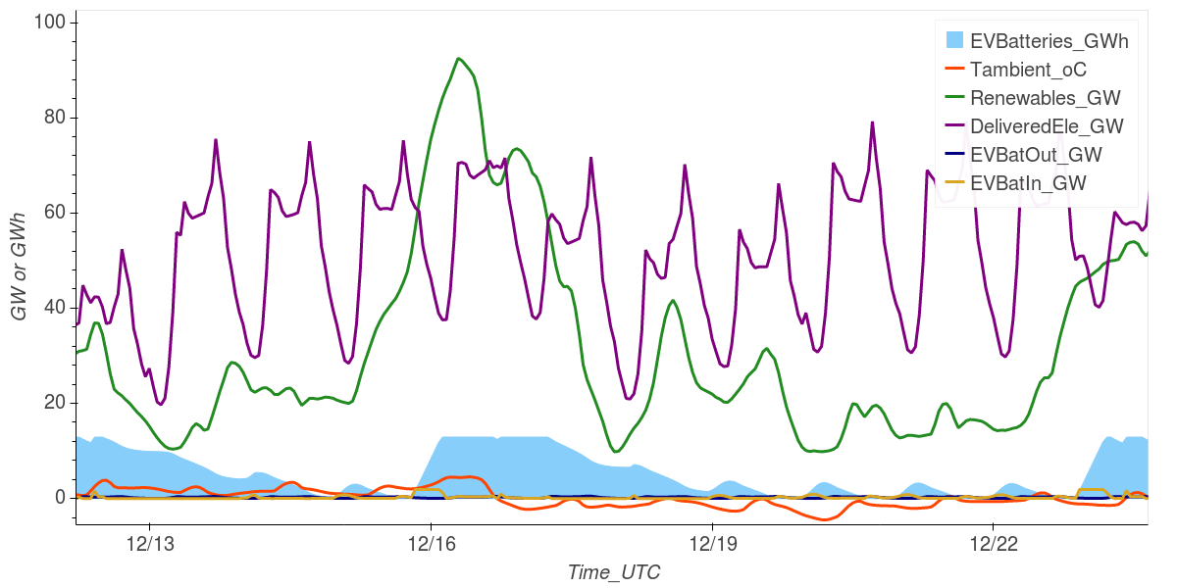
Heat demand variation
Detail 2010
UCL Energy Institute: EnergySpaceTime group
Variation driven by:
Social activities
Meteorology
Stationary:
Buildings
Industry
2009-2011
Note: light faded blue is renewables not heat demand
Electric vehicles:
Buildings on wheels need heating/cooling!
UCL Energy Institute: EnergySpaceTime group
Notes:
Mark

Slide 13
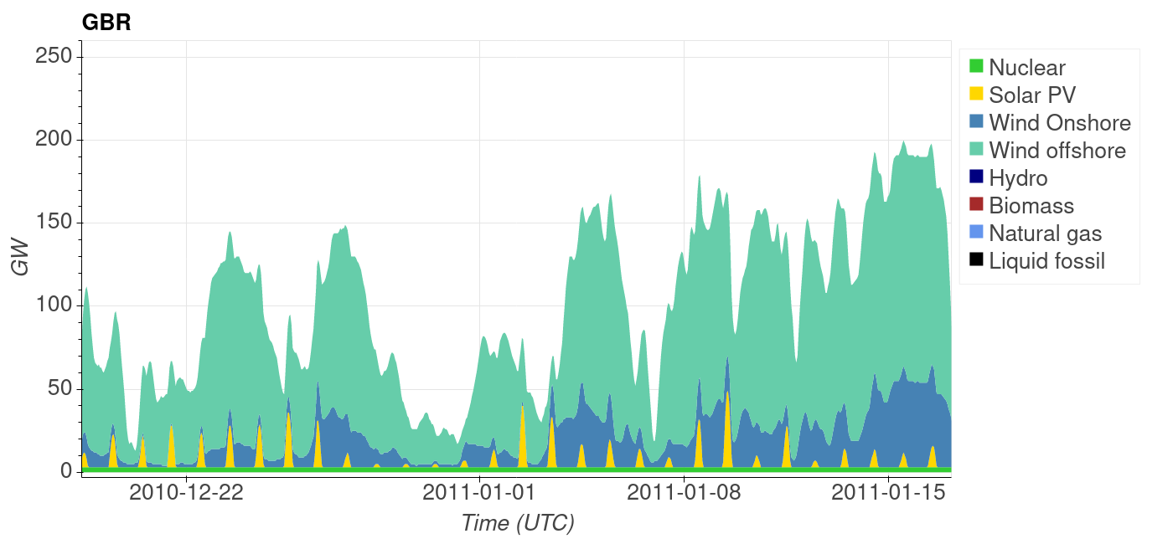
Primary supply illustration
UCL Energy Institute: EnergySpaceTime group
Wind and solar have no integral storage
Wind varies, generally more in the winter than summer
Solar: none at night (!) and less in the winter than summer
Hydro: has some storage but varies with precipitation
Nuclear generation is fairly constant except when maintenance or fault
Detail 2010-2011
Notes:
Mark

Slide 14
Designing zero emission systems
UCL Energy Institute: EnergySpaceTime group
To match variable or inflexible low emission energy sources to variable energy service demands, we design with these components:
Energy services
Efficiency
Intermediate conversion
Primary supply mix
Storage mix
Interconnectors to average demands/supplies
Notes:
Mark

Slide 15
Primary resources scope
UCL Energy Institute: EnergySpaceTime group
Resources and technologies currently in widespread use:
Renewable solar and wind resources are very large; biomass, hydro, geothermal etc. are limited
New nuclear beyond Hinkley is excluded for reasons including waste, cost and generic risk
Fossil fuels produce greenhouse gas and are excluded
There is no proven kerosene substitute for long range aircraft, so biomass is reserved for this.
Notes:
Mark

Slide 16
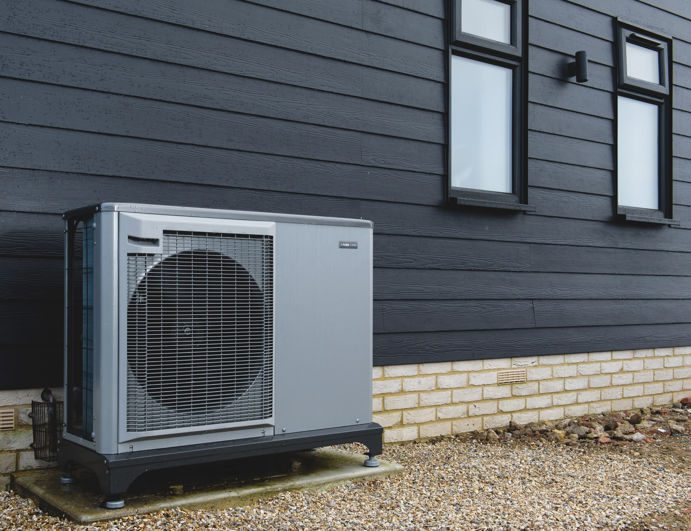
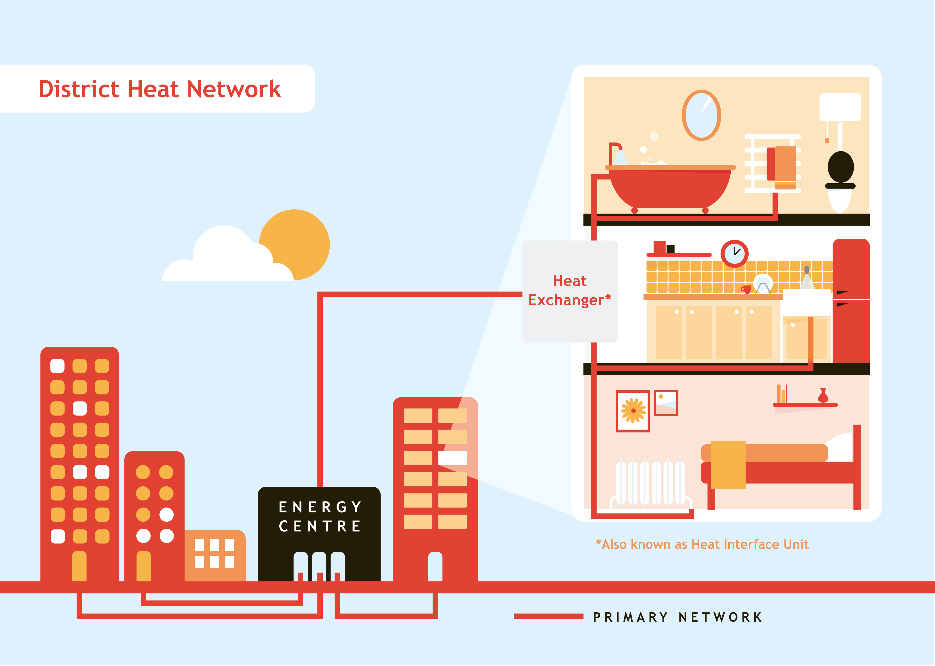
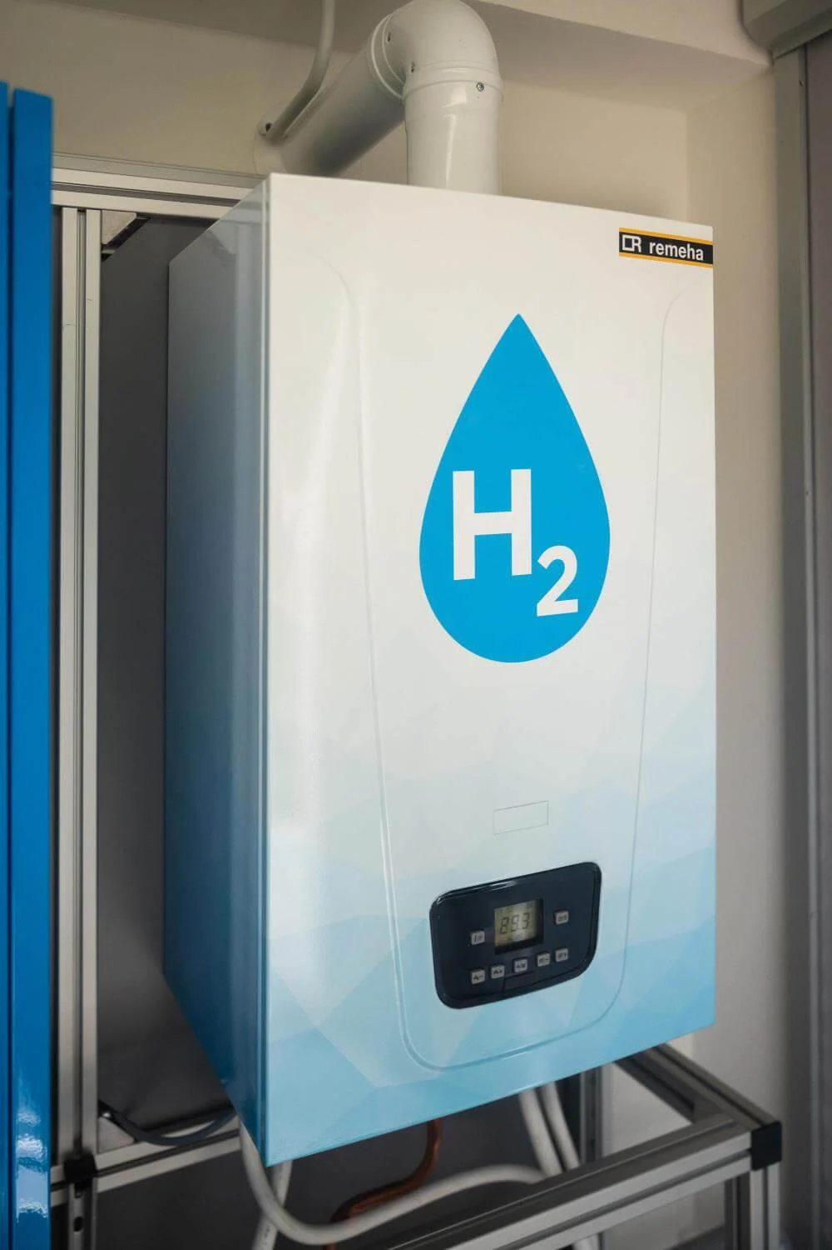
Heating technologies using zero emission electricity
UCL Energy Institute: EnergySpaceTime group
Many resources and technologies can produce heat – solar, geothermal, biomass etc. etc.
Selected: heat pumps (HP), district heating (DH) and electrolytic hydrogen (H2) boilers; all widely used except H2.
Heat pumps (HP)
District heating (DH)
(Electrolytic) H2
Notes:
Mark

Slide 17

UCL Energy Institute: EnergySpaceTime group
Consumer heat and cool supply – reversible electric heat pump
Climate change will bring warmer years and more extreme hot and cold spells. Can a single system manage in these conditions?
A reversible electric heat pump provides:
Space heating and cooling
Hot water
Heat for appliances
Storage:
Small tank for hot water
Large heat or cool storage : or perhaps a battery
What is the potential for personal comfort systems (PCS)?
Split reversible air conditioner/heater heat pump?
Flexible, multi-function, spatiotemporal control.
Hot water and heat storage in some systems.
Millions installed
Notes:
Mark

Slide 18
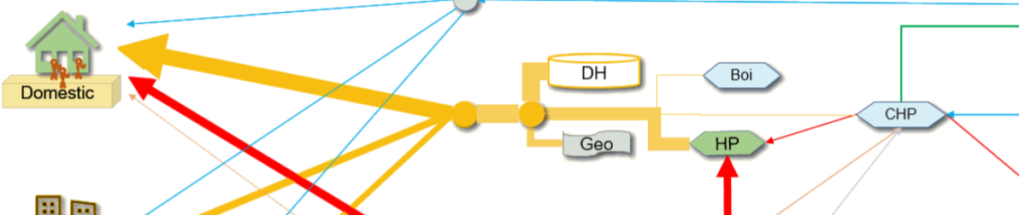
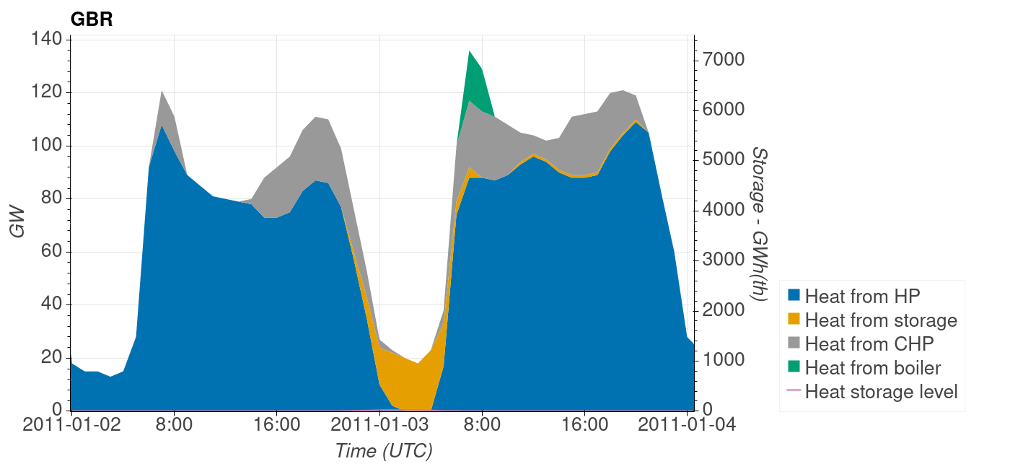
District heat – a flexible, multi heat source system
UCL Energy Institute: EnergySpaceTime group
District heating has a major system balancing role using:
low cost heat storage
multiple heat sources (heat pumps, CHP, boilers)
These may be adjusted to conditions of renewable surplus or deficit.
Surplus: run HPs
Deficit: use storage, run CHP, boilers
2009-2011
Notes:
Mark

Slide 19
Nine zero emission designs explored
UCL Energy Institute: EnergySpaceTime group
Architecture acronyms used in this presentation
Core scenarios
Three core heat shares are explored:
District heat: 70%; consumer heat pumps 30%
Consumer heat pumps 70%; district heat: 30%;
Electrolytic hydrogen: 70%; consumer heat pumps 30%
Then:
6 DH designs with varying insulation, generation and interconnector mixes
2 variant climate scenarios with +2 oC and +4 oC ambient temperature increment
Each design has different capacities of:
Renewables
Storage
Interconnector
heat shares
System design
Climate
Notes:
Mark

Slide 20
Annual: heat and cooling demands
UCL Energy Institute: EnergySpaceTime group
Total heat demand in the core scenarios is 464 TWh, similar to today’s demand. This falls to 402 and 346 TWh in the climate change scenarios of +2 oC and +4 oC respectively.
Heat demand sensitivity
Building insulation: 3 TWh/SHL_%
Climate Change: -30 TWh/oC
Electricity demand for cooling
Building insulation: 0.6 TWh/SHL_%
Climate change: 35 TWh/oC
Electricity demand for BEVs
Climate change: -1.5 TWh/oC
Heat
Notes:
Mark

Slide 21
Heat and cool demand with climate change
UCL Energy Institute: EnergySpaceTime group
Climate change was modelled by adding +2 oC and +4 oC to historic weather data.
Air conditioning was assumed limited to the services sector.
The model indicates that AC is increased by climate change as much as space heat is reduced
Climate change will affect the seasonal variation in demand – more in summer, less in winter – and this will alter the optimal capacities of wind and solar.
Reversible consumer or DHC heat pumps can provide heat and cool.
Note: these are heat/cool demands, not electricity
Notes:
Mark

Slide 22
Electricity consumption
UCL Energy Institute: EnergySpaceTime group
Electricity consumption includes that by:
Consumers the intermediate system (DH, hydrogen electrolysis etc.) and losses in stores and transmission
Electric transport is about 25% of total consumption
H2 requires 4x electricity per heat output so about 75% more consumption
Notes:
Mark

Slide 23
Primary renewable capacities and annual production
UCL Energy Institute: EnergySpaceTime group
Hydrogen requires about 80% more primary capacity than DH and HP
Generation spillage ranges from 40% to 50%.
Decreasing spillage would require more storage, interconnector or other capacity.
The UK systems here all net export electricity to Europe.
Notes:
Mark

Slide 24
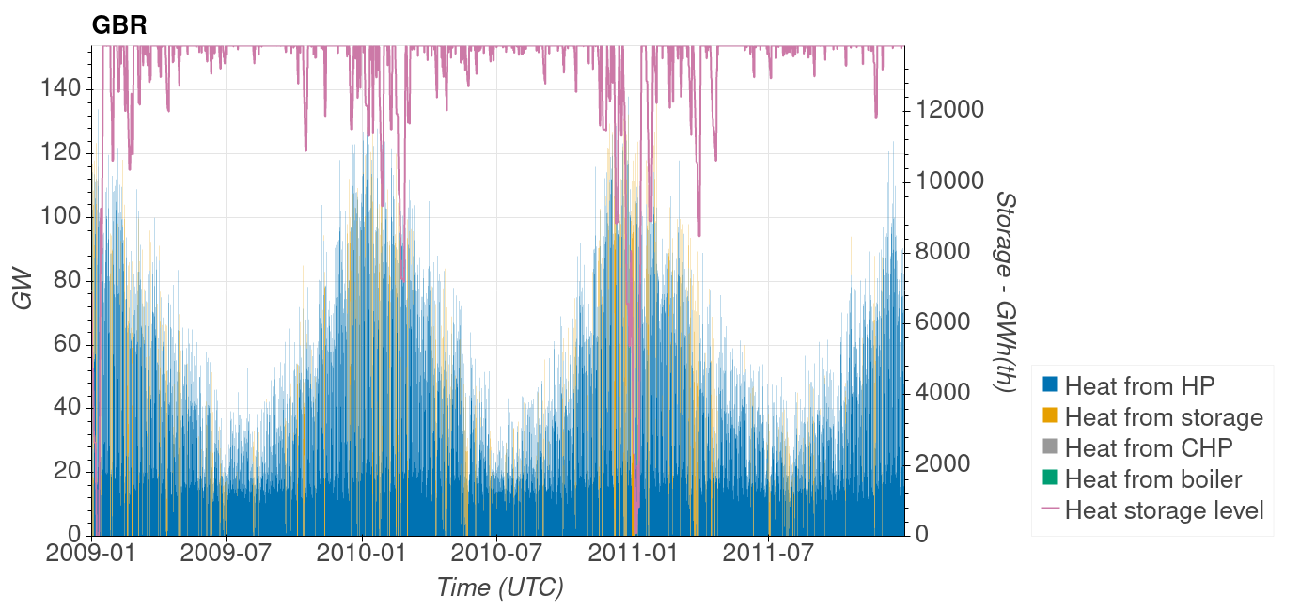
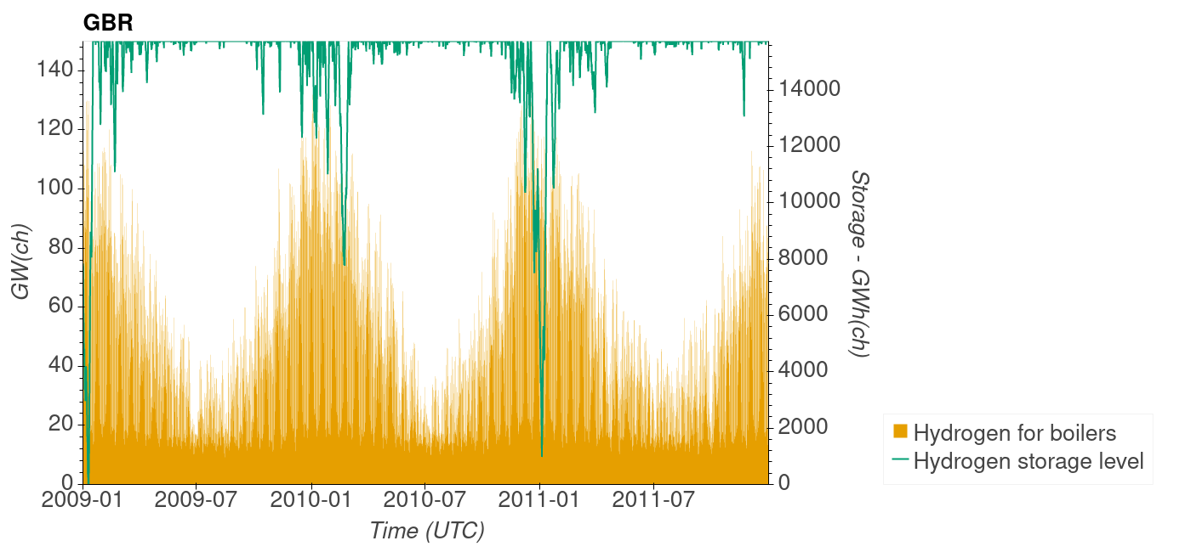
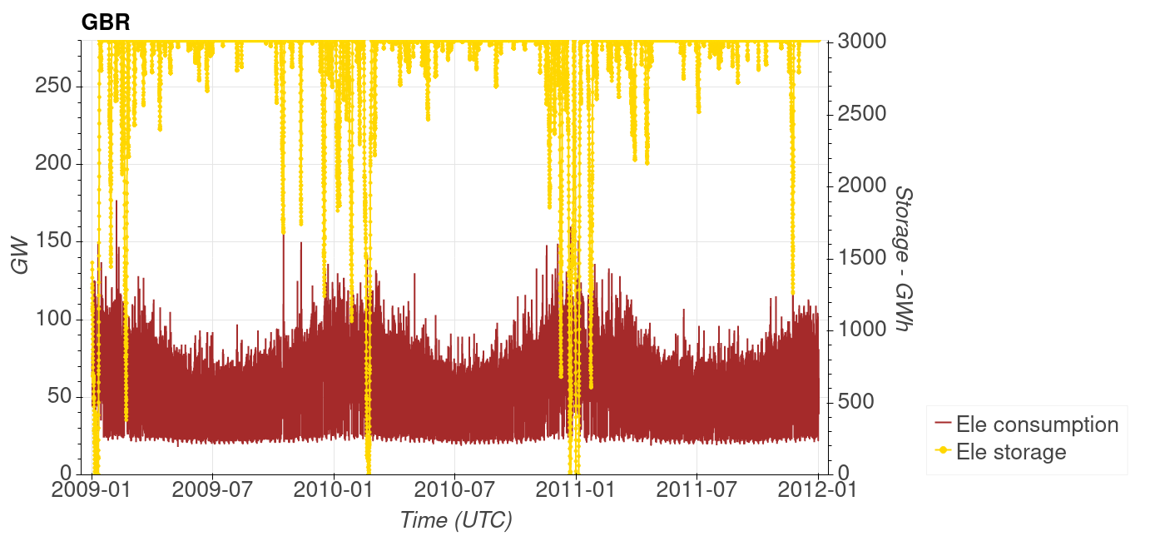
Hourly flows and storage 2009-2011
a
UCL Energy Institute: EnergySpaceTime group
a: Hourly heat storage level (right axis) and delivered heat from heat pumps, heat storage, CHPs, boilers (left axis).
b: Hourly hydrogen storage level (right axis) and delivered hydrogen for ammonia production and for boilers (left axis).
c: Hourly electricity storage level (right axis) and system electricity consumption (left axis).
They have similar patterns, but electricity storage is used to also meet non-heat demands
There are few hours when stores are empty
b
c
Notes:
Mark

Slide 25
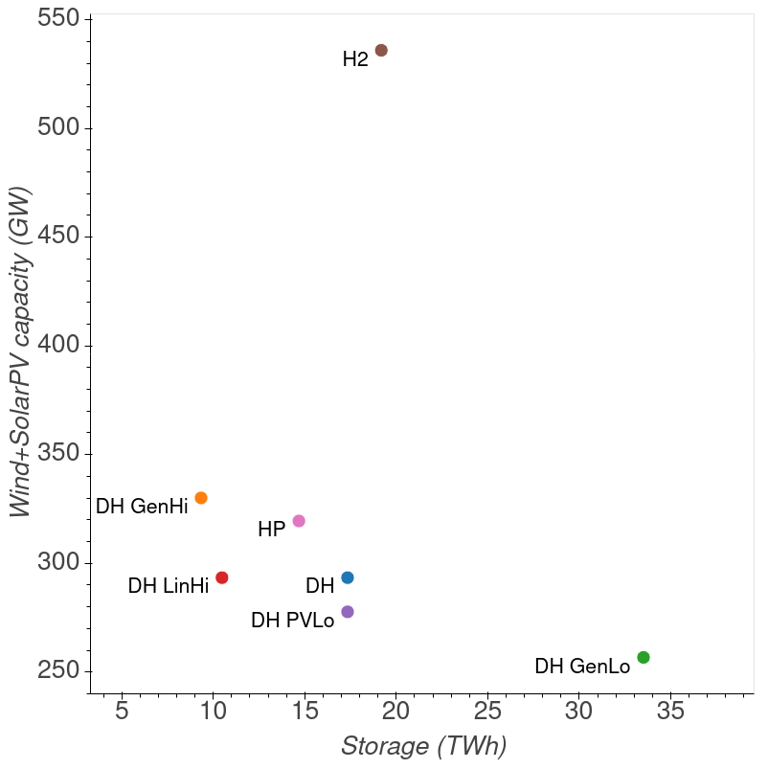
Storage
UCL Energy Institute: EnergySpaceTime group
The amount of total storage in the designs varies; the more renewable capacity the less storage is needed.
The amounts and types of storage varies with heat share, renewable capacities and interconnectors.
Increasing one of renewable, storage and interconnector capacity can allow reductions in the other two.
Notes:
Mark

Slide 26
Costs: whole system and electricity subsystem
UCL Energy Institute: EnergySpaceTime group
Capital costs are annuitized using technology unit costs (£/kW, £/kWh), life (yrs) and interest rate 5%/a.
O&M costs are about 35% of the total annual cost.
Notes:
Mark

Slide 27
Costs cumulated across the system
UCL Energy Institute: EnergySpaceTime group
The costs may be cumulated from consumer through intermediate to primary system components.
Consumer heat pumps have higher capital costs for the consumer than hydrogen boilers or DH connections.
Upstream of the consumer, the main difference in costs occurs because of the greater primary energy consumption of H2, and therefore costs of primary supply.
Notes:
Mark

Slide 28
Renewable and natural gas heating costs and emissions
UCL Energy Institute: EnergySpaceTime group
Systems
Zero emission: HP, DH, electrolytic H2 most costly
Zero net emission with negative emissions: 3 natural gas systems: boiler, gas to H2, gas CHP
Natural gas uncertainties:
future gas prices
upstream gas emissions
technologies: DACS, SMRCCS, CHPCCS
Notes:
Mark

Slide 29
Security and resilience of zero emission systems
UCL Energy Institute: EnergySpaceTime group
Hourly demands are met over 35 years’ weather
No fossil or biomass energy import and net electricity import
For resilience to climate change, reversible heat pumps can provide heat and cool, unlike hydrogen boilers.
Widespread electricity failure can occur due to transmission faults, cyber attack, or environmental conditions.
Nuclear capacity is small so its risk to the system is low.
To insure against extreme meteorology causing high demand and low renewables ‘backstop’ capacity might be built. For example, 100 GW of natural gas turbines would add about 4% of total system capital cost and 2% of annual system cost. Gas storage would additionally be required.
Notes:
Mark

Slide 30
Summary
UCL Energy Institute: EnergySpaceTime group
Nine zero emission energy systems have been designed that:
Use current commercial technologies, except hydrogen boilers and networks
Have zero emission: renewable (excluding biomass) and nuclear electricity
Meet demands hour by hour across 35 years of weather without and with climate change
Have net exports – but nuclear fuels imported
Hydrogen heating has higher primary energy needs and costs than consumer heat pumps or DH.
Require major changes to consumer and public supply systems.
It is not claimed the systems are the best designs – further work is needed…!
Notes:
Mark

Slide 31
Indicative implementation rates
UCL Energy Institute: EnergySpaceTime group
The possible development path from the current system to a zero emission system has not been analysed here
How fast can the installation rate of consumer and public systems be ramped up given the needed skilled labour, financing and so on?
What regulatory or market measures are required?
The rates of implementation required to maintain the capacities in a net zero system given technology lifetimes are shown.
The rate of primary capacity build for H2 is about 70% higher than for DH and HP, because H2 requires much more electricity.
Notes:
Mark

Slide 32
Heating systems comparison
UCL Energy Institute: EnergySpaceTime group
Building types and heat load density affect costs and practicalities
HP, DH and H2 are mainly urban options; elsewhere HP
Consumer and district heat pumps can heat and cool
Heat pumps might replace boilers and then later the dwellings is connected to DH
Notes:
Mark

Slide 33
Next steps being considered
UCL Energy Institute: EnergySpaceTime group
Include :
  Aviation fuel production from biomass, atmospheric carbon, hydrogen and electricity
  Negative emissions - Direct Air Capture and Sequestration
  Detail on efficiency – insulation, personal comfort systems potential and costs
  Hydrogen for iron production
  Domestic air conditioning and district heating and cooling
  Building storage: passive fabric, active thermal, battery
Develop better design procedures including optimisation
Extend modelling to west Asia and north Africa to reduce storage?
Notes:
Mark

Slide 34


UCL Energy Institute: EnergySpaceTime group
Thank you for your attention
The paper by Gallo Cassarino and Barrett Meeting UK heat demands in zero emission renewable energy systems using storage and interconnectors has been accepted for publication in Applied Energy.
The first version of ESTIMO was coded by Mark Barrett in python and then greatly expanded and made operational by Tiziano Gallo Cassarino. The scenarios in this presentation were mainly prepared by Tiziano.
If you have comments or would like to discuss the work, please contact us:
t.cassarino@ucl.ac.uk
mark.barrett@ucl.ac.uk
Notes:
Mark

Slide 35
UCL Energy Institute: EnergySpaceTime group
Supplementary information follows
On heat scenarios:
New slides
More commentary
Results for other scenarios and countries
Notes:
Mark

Slide 36
UCL Energy Institute: EnergySpaceTime group
ESTIMO – Energy Space Time Integrated Model Optimiser
ESTIMO is a national/international scale dynamic model.
For each hour and each European region, ESTIMO concurrently simulates :
Service demands driven by social activity and weather
Renewable and nuclear, zero emission supplies
Intermediate energy conversion
Storage flows and levels
Trade between GBR and European regions
Optimisation not in ESTIMO but ETSimple
36
Notes:
Mark

Slide 37
UCL Energy Institute: EnergySpaceTime group
ESTIMO – interconnector network topologies
How to achieve the best balance between computability and accuracy?
Initially a star formation is chosen: a year’s hourly simulation takes ~5 minutes per node on a laptop.
Mesh
Realistic
Requires hourly optimisation
Computation increases rapidly with N of nodes
Star
Simplification, unrealistic but engineering feasible
Computation increases linearly with N of nodes
Can inform real time dynamic markets
37
Notes:
Mark

Slide 38
ESTIMO – energy service demands
UCL Energy Institute: EnergySpaceTime group
Energy service demands may be defined as the minimum energy required to perform a task; however this definition is generally difficult to implement, so service demand is often equated with the energy input to a device such as a refrigerator, or the energy output from a device such as a heat pump. It is especially hard to define a service demand for comfort provision (space heating and cooling) as it depends so much on clothing levels, temperatures and the spatiotemporal control of systems. Energy service demands are divided by the last conversion efficiency to give the energy input (delivered) to devices.
Four sectors are modelled (domestic, services, industry, transport) and eight energy services are included: space heat and cool, lighting, other heat (water, process), equipment, cooking, refrigeration, transport. Service demands are driven by different normalised hourly use patterns (U(h)) for each sector and end use including building occupancy and transport.
Weather independent demands Di are modelled simply: Di(h) = U(h) (Average annual demand) Watts
Weather dependent demands Dw are primarily driven by ambient temperature (Ta oC) and solar radiation (Sol W/m2). 35 years of hourly MERRA data by 0.5 oLat/Lon have been assembled and weighted by population to derive weather data for each European country. Space heat/cool demands are dependent on the occupied internal temperature (Ti oC), specific heat loss (SHL) of the building or vehicle, and incidental gains (I) from people, appliances and solar radiation: Dw(h) = U(h) [SHL (Ti-Ta) – I] Watts. This enables the exploration of varying internal temperatures and efficiency (insulation etc.), as well as past and future climates.
If Dw>0 then there is a space heat load, if Dw<0 a cooling load. Currently it is assumed that air conditioning is confined to the services sector. ESTIMO does not yet account for the thermal mass of buildings and the use of this to store heat or cool for limited periods.
38
Notes:
Mark

Slide 39
Heat demand and emissions
UCL Energy Institute: EnergySpaceTime group
The ECUK (2019) gives estimates of energy delivered by end use. These deliveries may be multiplied by nominal efficiencies for each fuel for converting energy into emitted heat. Emitted heat can be used as a proxy for heat services, but services will be less than emitted due to inefficiencies such as heating unoccupied houses. Total heat emitted (2019) is about 492 TWh. This excludes heat in washing appliances.
Energy deliveries may be multiplied by emission factors to estimate CO2 emission: heat accounts for about half of energy emissions; this fraction is growing rapidly as electricity decarbonises, but not gas.
We have assumed future heat demand to be similar to today but with improved efficiency (insulation) reducing space heating more than increases due to population and economic growth.
Notes:
Mark

Slide 40
Resources and technology scope 1
UCL Energy Institute: EnergySpaceTime group
The overall aim is net zero GHG emission. Fossil fuels, even with CCS, produce GHG and so these are excluded. Negative emissions can be achieved with processes such as DACS, BECCS and afforestation. However, these are either unproven in technical, commercial and environmental terms, or constrained; so negative emissions are not included in the modelling here. Furthermore, carbon from such sources will be required for producing synthetic kerosene as there is no current substitute fuel for long range aircraft.
Primary sources with near zero operational emissions include most renewables and nuclear; the embedded GHG incurred in technology construction and installation are assumed to reduce to zero with industrial decarbonisation. Biomass is assumed to be constrained and generally reserved for carbon based fuels such as kerosene. Hydro is also constrained. It is assumed the resources of wind and solar are sufficient for any feasible demand.
There are many resources and technologies and combinations thereof for producing heat services. There are innumerable types and combinations of technologies; these commonly proposed options are currently excluded:
Notes:
Mark

Slide 41
UCL Energy Institute: EnergySpaceTime group
Consumer heat and cool supply – reversible electric heat pump
Climate change will mean summers 1-5 ºC hotter, more extreme weather still with cold spells. Can a single system manage in these conditions?
A reversible electric heat pump provides:
Space heating and cooling
Hot water
Heat for appliances
Storage:
Small tank for hot water
Large heat or cool storage for ~1 day’s demand. (Or perhaps a battery will be a similar cost and more flexible?)
What is the potential for personal comfort systems (PCS)?
Split reversible air conditioner/heater heat pump?
Flexible, multi-function, spatiotemporal control.
Hot water and heat storage in some systems.
Millions installed
Notes:
Mark

Slide 42
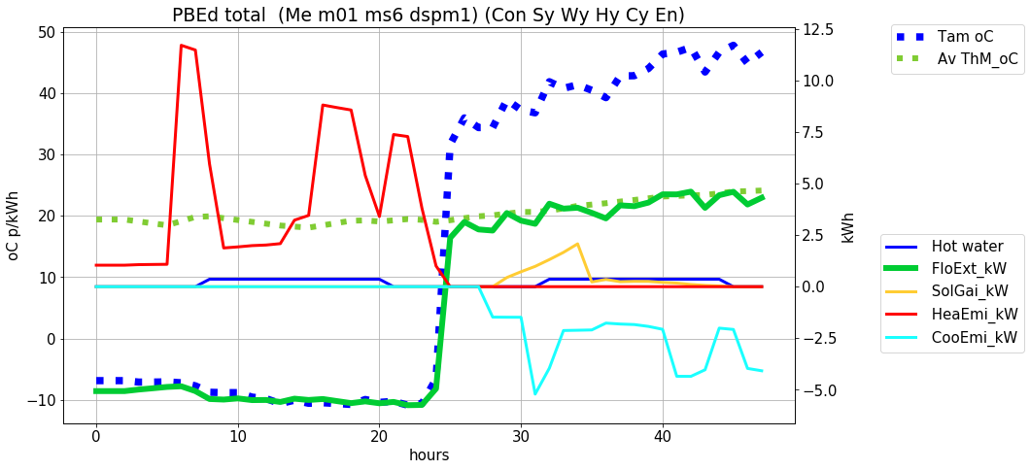
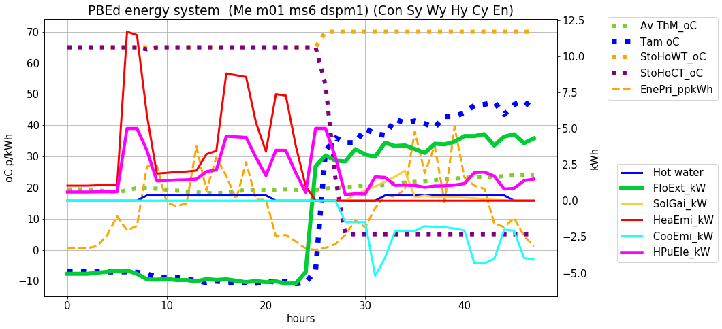
Consumer heat and cool supply simulation – peak design conditions
UCL Energy Institute: EnergySpaceTime group
Winter (extreme)
Summer (extreme)
Human health requires air temperature around 16-26 ºC. Climate change will mean UK summers 1-5 ºC hotter, but still cold spells.
A reversible heat pump can provide comfort in extreme cold and hot conditions
How will demand conditions be correlated with renewable supply?
What impact will millions of such systems have on electricity and other supply?
How can heat and cool storage be used for national system management?
Simulation with separate CoHeCo model =>
Notes:
Mark

Slide 43
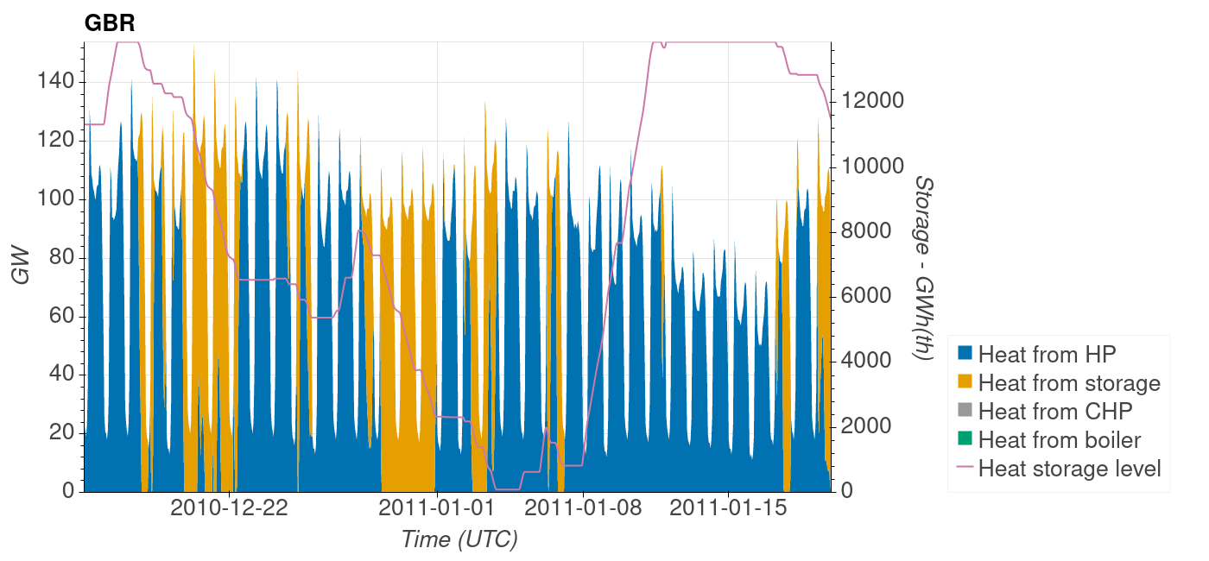
District heat – low storage period
UCL Energy Institute: EnergySpaceTime group
Scenario: DH core
Detail 2010-2011
Illustration of dynamically changing heat supply mix.
Notes:
Mark

Slide 44
District heat
Detail 2011
UCL Energy Institute: EnergySpaceTime group
Scenario: DH core
District heating potentially has a major system balancing role to play in managing variable uncontrollable supplies by using low cost heat storage, and multiple heat sources (heat pumps, CHP, boilers) which can dynamically adjust to conditions of renewable surplus or deficit.
Surplus: run HPs
Deficit: use storage, run CHP, boilers
2009-2011
Notes:
Mark

Slide 45
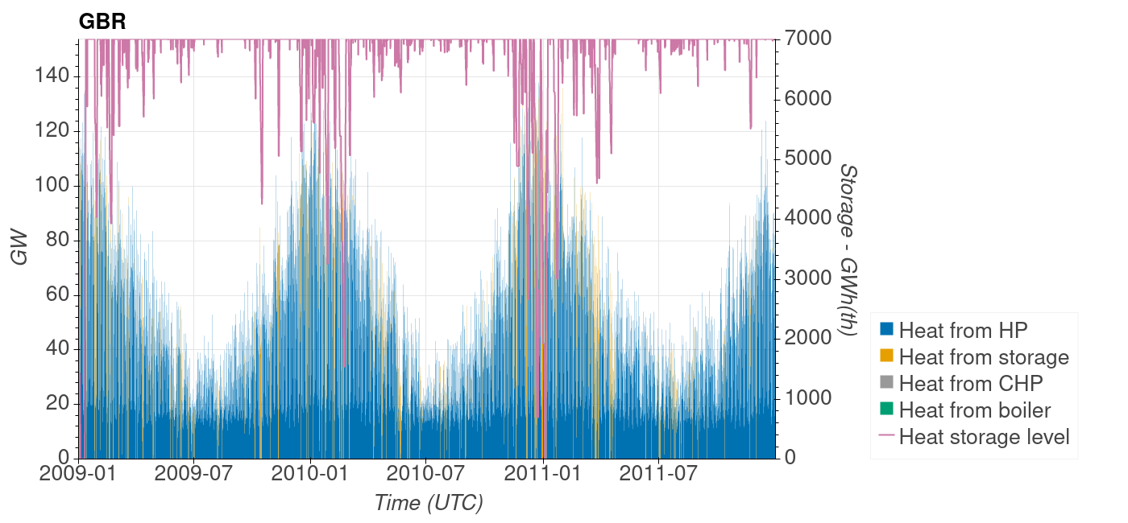

District heat – storage in scenarios
UCL Energy Institute: EnergySpaceTime group
DH GenHi
Top: DH GenHi scenario with 33% more wind and solar capacities, and 50% less storage size than the core
Middle: core DH architecture.
Bottom: DH GenLo scenario with 33% less wind and solar capacity, and 100% more storage than the core DH architecture.
DH
DH GenLo
Notes:
Mark

Slide 46
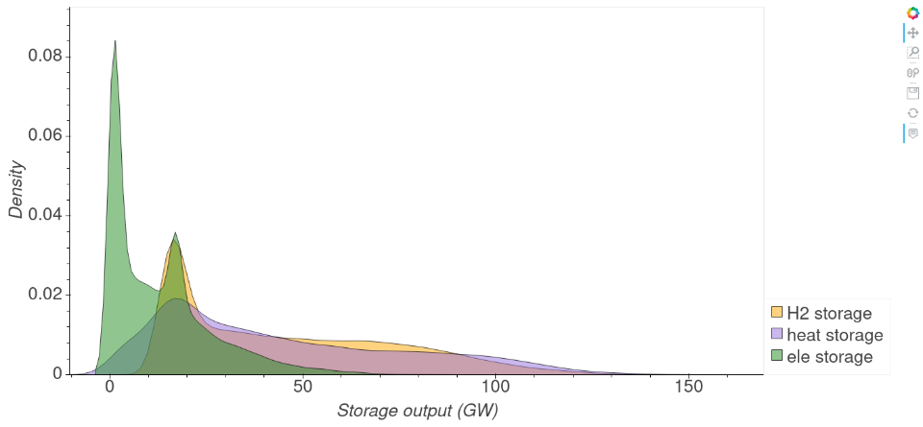
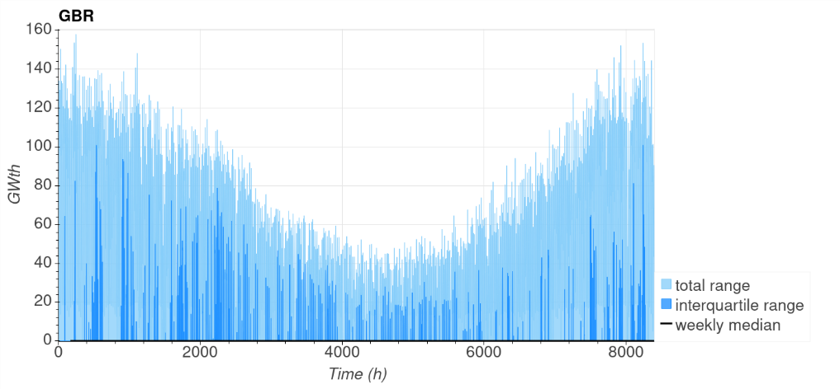
Storage over 35 years
UCL Energy Institute: EnergySpaceTime group
a
Hourly simulation of the storage output over 35 years (1980-2015) of historic meteorology for the three core scenarios
a: Frequency distribution of the hourly output from the hydrogen storage (H2 core scenario), the heat storage (DH core scenario), and the electricity storage (HP core scenario).
b: Annual distribution of the hourly heat storage output in the DH scenario.
b
Clarify
Notes:
Mark

Slide 47
Commentary: climate change
UCL Energy Institute: EnergySpaceTime group
The focus has been on heat, so the modelling of air conditioning is less developed and the results are indicative only. Inward heat flows through a building envelope and incidental gains from people, equipment and the sun can drive building temperatures above comfortable levels. Depending on design details, insulation can moderate or exacerbate overheating. Air conditioning (AC) heat pumps transfer heat from the interior to the outside to maintain comfort.
Climate change was modelled by simply adding temperature increases of +2 oC and +4 oC to historic MERRA data. Air conditioning was assumed limited to the services sector. The model indicates that AC is increased more by climate change than space heat is reduced, such that decreases in total UK space heat demand are roughly balanced by increases in the service sector AC load (cool, not electricity). The effect on BEV demand is not very large. Climate change will affect the seasonal variation in electricity demand – more in summer, less in winter – and this will alter the optimal capacities of wind and solar.
Reversible heat pumps provide heat and cool. These may be in buildings (e.g. split AC/heater) as explored in the next two slides or in District Heating and Cooling (DHC) systems.
Note: these are heat/cool demands, not electricity
Notes:
Mark

Slide 48
Annual: deliveries by distribution networks
UCL Energy Institute: EnergySpaceTime group
Deliveries reported here are direct to consumers but exclude electrofuels to ships. Consumption by intermediate facilities such as DH and H2 electrolysers are also excluded.
The total deliveries of electricity, district heat and hydrogen through distribution networks are similar though differentiated by consumer conversion efficiencies: consumer heat pump efficiency > consumer DH connection efficiency > consumer hydrogen boiler efficiency.
Notes:
Mark

Slide 49
Annual: electricity delivered for heat
UCL Energy Institute: EnergySpaceTime group
Deliveries of electricity for heat include all flows to consumers in the network with voltages less than long distance transmission voltages of 400 kV and 275 kV. This includes smaller domestic and non-domestic consumers (mostly 230 V), and larger consumers at voltages of up to 33 kV. Electricity to facilities producing secondary energy (DH heat, electrolysis, ammonia etc.) is excluded.
The total deliveries of electricity for heat are highest in HP and the same in DH and H2 as they have the same HP fraction.
Notes:
Mark

Slide 50
Peak flows
UCL Energy Institute: EnergySpaceTime group
The peak flows at various points in the system are recorded. Note that those presented may not occur at the same time so they cannot be added.
The peak heat demand in the core scenarios is 170 GW. This increases if less insulation, and falls if more insulation or climate change.
The peak electricity consumption is highest in H2 because of overall supply, losses and electrolyser demand. Lowering the capacity of electrolysers would reduce this peak, but mean that less surplus electricity could be absorbed and stored.
Notes:
Mark

Slide 51
Technical and cost data
UCL Energy Institute: EnergySpaceTime group
ESTIMO calculates capital, O&M and fuel costs.
The current performance, capital and operational costs of many individual technologies are fairly well known. Most performance and cost data used here are projected for 2040, from the Danish technology database*. Uncertainties are generally large for hydrogen for which there are no extant large scale distribution and use systems. Projected costs are uncertain. The economies of scale are accounted for in terms of efficiency and unit cost. Nuclear costs are uncertain and opaque, but nuclear capacity is small in the scenarios so has little effect on total costs.
Perhaps the greatest uncertainties concern the costs of new and upgraded distribution networks. These have been calculated as a capital cost per consumer increasing for different consumer fractions served by DH/HP/H2 to reflect heat load density decreasing. Network losses as a fraction will partially depend on network length per consumer.
* https://ens.dk/en/our-services/projections-and-models/technology-data
Notes:
Mark

Slide 52
Costs: disaggregated
UCL Energy Institute: EnergySpaceTime group
ESTIMO calculates capital, O&M and fuel costs.
Capital costs are annuitized using unit capacity costs (£/kW, £/kWh), technology life (yrs) and an interest rate of 5%/a.
H2 total system costs are 30% higher than DH and HP, mainly because primary capacity is higher due to the inefficiency of heating with electrolytic hydrogen as compared to heat pumps.
Notes:
Mark

Slide 53
Costs of heat and electricity
UCL Energy Institute: EnergySpaceTime group
Energy systems are interconnected systems with some components serving multiple demands. Estimation is needed to separate out the cost of heat, but note that these are for 70:30 mixed DH/HP/H2 systems:
The costs of components solely or mainly for heating may be summed – these include consumer heaters, heat and hydrogen networks, DH components, and H2 electrolysers.
The cost of electricity supply for heating (heat pumps, electrolysis) may be estimated as the fraction of electricity consumption for heat times the total cost of electricity supply.
These two elements may then be summed. The sums may then be divided by heat demand to derive the unit cost of heat. 70% H2 heat costs about 70% more than DH or HP heat.
Similarly for electricity. The total cost of electricity in H2 is higher because of the greater consumption, but there is little variation in unit p/kWh costs.
Notes:
Mark

Slide 54
Cost comparisons: single zero emission vectors
UCL Energy Institute: EnergySpaceTime group
The core scenarios have mixes of heat shares DH (DH-70:HP-30:H2-0); HP (DH-30:HP-70:H2-0); H2 (DH-0:HP-30:H2-70). Therefore the cost comparisons do not relate to single vectors.
As shown below, an attempt has been made to separate out the costs for each vector, with one difficulty being the estimation of additional electricity network and storage costs incurred by each vector.
Green hydrogen heating costs about 80% more than heat pumps or district heating
Notes:
Mark

Slide 55
Commentary: electricity network
UCL Energy Institute: EnergySpaceTime group
The current UK peak electricity demand is about 55 GW. Modelled peak flows account for storage use in general; but consumer storage apart from in EVs is not modelled; however several cold days with low renewables would deplete most practicable consumer stores. Delivered peak flows are 142 (DH), 148 (HP) and 121 GW (H2) or an increase of about 2.5 times the current peak. The H2 distribution peak is 27 GW or 20% less than for HP. A major contributor to this peak is EV charging at about 100 GW; about 40% of dwellings have no off-road parking, so a fraction of this would be to charging stations, some of which would have high voltage supply. The peak consumption on the high voltage grid is 148 (DH), 151 (HP) and 313 GW (H2), with the H2 peak being largely driven by electrolyser capacity which is assumed connected to high voltage transmission. Transmission is assumed to accommodate the maximum generation of 257 (DH), 280 (HP) and 474 GW (H2).
In all scenarios, the capacities of the distribution and transmission electricity networks will have to be greatly increased, with much of the network being upgraded. Assuming a 60 year asset life, half the existing network will be replaced by 2050 in any scenario. In the minimum 30% HP heat share scenario, HPs may mainly be in off-gas-grid and low load density areas where the network length per consumer is high, but a fraction of this will be overground and underground installation per metre may cost less than in cities.
Notes:
Mark

Slide 56
Commentary: technology uncertainties
UCL Energy Institute: EnergySpaceTime group
Technologies
Heat pump and district heat technologies are well known. In the UK in 2021, about 0.3 M consumers have heat pumps and some 0.2 M consumers have DH; tens of millions of consumers in Europe are served with these. There is no extant large scale application of new or adapted hydrogen distribution networks, building internals and boilers, so there is uncertainty about implementation and cost.
The scenarios here use costs projected for 2040. These are generally uncertain, but particularly for wind, solar and batteries as these technologies are still being rapidly developed technically and in unit and mass production scale, and the substantial historic cost reductions are usually assumed to continue, albeit more slowly.
Distribution networks
A major uncertainty is the cost of new, upgraded or adapted distribution networks comprising transmission (cable, pipe) and ancillary gear (transformers, compressors etc.). Electricity and DH network transmission costs depend on many factors, perhaps most important are network length and the cost in laying equipment underground. For hydrogen, the costs of adapting existing gas networks, including in consumers’ premises are not well known.
Notes:
Mark

Slide 57
Commentary: supply security and resilience
UCL Energy Institute: EnergySpaceTime group
Electricity transmission is the spine of the systems designed and there is the possibility of widespread failure due to cascading faults, cyber attack, or extreme environmental conditions. A significant system wide risk is sustained low ambient temperature, and therefore high demand, coupled with low renewable output. The systems explored meet hourly demands as driven by weather of the last 35 years, including the stress year 2010. The systems have zero operational emission and do not rely on imported fossil or biomass fuels, and they net export electricity. Biomass consumption is zero for heating and electricity, and is assumed reserved for aviation fuelling. Nuclear capacity is small so its generic risk to the system is low.
Climate change will in general decrease space heat demand and increase space cooling demand in buildings and vehicles. Climate change may not reduce the severity of stress periods for heating but will increase cooling loads. To offer resilience to climate change, reversible consumer or DH heat pumps can provide heat and cool, unlike hydrogen boilers. Climate change will alter wind and solar resources and correlations with demand, but research so far indicates little climate change impact on these renewables. Increased temperatures will impact on the cooling of thermal plant (mainly nuclear).
As the system evolves over the coming decades under varying meteorological conditions, there will be a decreasing frequency and magnitude of GHG emission. The demand, intermediate and primary system components should be developed in a reasonably coordinated way. If it looks like there is a risk of a supply shortfall in forthcoming years because of lack of coordination, or perhaps to meet a 1 in 100 year meteorology, then back-stop supply could be deployed, such as multi-fuelled DH CHP or non-CHP open cycle gas turbines (OCGT) using natural gas. Since the system is primarily electric, this provides security for most services. For example, 100 GW of OCGT with a unit cost of 300 £/kW would have a capital cost of 30 G£ and an annuitized cost of 2 G£/a. This represents about 4% of total system capital cost and 2% of annual system cost. Demand reduction through interruptible contracts is an additional option.
Notes:
Mark

Slide 58
Commentary: optimisation and system dynamic control
UCL Energy Institute: EnergySpaceTime group
Ideally, the system configuration – component capacities and connections - and dynamic control algorithm (Global Optimum Dispatcher, GOD, in ESTIMO) should be optimised at the same time, as they are co-dependent. But this is generally beyond current capability for complex multi-node systems with trading. Here, GOD and the connectivity of components is the same for all systems, but the capacities of the components are adjusted.
The approach taken has been to separately and iteratively generate ‘good’ designs using optimisation with simpler models coupled with manual adjustments to the component capacities, followed by simulation in ESTIMO. It is clear that considerable inter-substitution between renewable, storage and interconnector capacities is possible. The next step here is to optimise using ESTIMO rather than simpler models. It may be that much lower cost designs can be found. Plainly optima will depend on the relative costs of components, and the huge reduction in wind, solar and battery costs have radically transformed optima just in the past 15 years or so.
The dynamic control algorithm functions effectively in that it makes good use of available low emission supply hour by hour through controlling storage and trade flows. However it may not be optimal, particularly as it uses information for the current hour only. GOD may help informing the construction of practical operational markets that include pricing and competition. Constructing and modelling practicable dynamic markets is a most difficult problem.
Notes:
Mark

Slide 59
Commentary: renewable spillage
UCL Energy Institute: EnergySpaceTime group
A notable outcome of the architectures designed is the fraction of 40-50% of electricity, mainly renewable, that is spilled because it cannot be used, stored, or exported given the component capacities and operation of the designs. Reducing spillage would mean less investment in renewable generation, but generally more in conversion, storage and some transmission components; this is an optimisation question and ancillary analysis has shown that significant spillage leads to lower total cost. Extending the interconnector system geographically beyond Europe would further average demands and renewables and thereby reduce spillage and storage needs. In the systems explored here, the cost of the UK interconnector to central Europe is less than 1% of total UK system cost, whereas storage is around 10% of total cost; but interconnector costs are crudely calculated.
It may be that some of this spilled electricity could be used for purposes not modelled here, such as to power facilities for aviation fuel production or Direct Air Capture and Storage (DACS) of CO2, which can include other storage such as of aviation fuel and CO2. However the same question arises of balancing the capital costs of facilities for these purposes against the costs of renewables. In general, the higher the fraction of renewables absorbed, the more storage is needed, and the lower the capacity factors of plant using the electricity, and therefore the higher capital cost per unit of production of these facilities.
This is a complex optimisation problem.
Notes:
Mark

Slide 60
Consumer system implementation
UCL Energy Institute: EnergySpaceTime group
A key issue is the speed and ease of changing the energy system to transit to zero emission.
The most difficult part of the system to change is that owned by consumers because of capital costs, acceptance, disruption and therefore choice. Changing the public intermediate and primary parts of the system is less problematic as the rapid increases in wind and solar generation have demonstrated.
Consumer heat pumps require space and access to environmental heat, and noise and visual obtrusion can be problematic
especially in high density areas and particular dwelling types. Heat pumps have higher consumer end capital cost than DH and H2: about 63% of dwellings are owner-occupied for which there is the problem of capital financing; whereas in the remaining 37% of dwellings, the capital costs can be paid through rent.
District heating. Most DH would be new and installed on an area basis. DH has little impact at the consumer end in terms of space and noise.
A HP to DH development path might be:
Replace gas boilers (life about 15 years) as they ‘die’ with reversible heating/cooling heat pumps.
Connect DH(C) to the HP internal system as and if DH(C) arrives at the consumer.
Hydrogen boilers would be similar to gas boilers but may be constrained such as in high rise flats. H2 is assumed to largely use the existing gas network, and would be implemented on an area basis with all current gas consumers having to switch from natural gas to H2 or HP.
The economics of DH and H2 are partially dependent on the fraction of consumers who connect to these networks within an area. A question is then how to ensure an adequate fraction do connect.
Notes:
Mark

Slide 61
Indicative implementation rates
UCL Energy Institute: EnergySpaceTime group
The rates at which technologies need to be installed depends on the lifetimes of the current and future technologies and the total capacity of each required by a certain date (e.g. 2050).
The table indicates the rates of implementation required to maintain the capacities in a net zero system given technology lifetimes. It is notable that the rate of primary capacity build for H2 is 80% to 70% higher than for DH and HP respectively.
To calculate the year by year installation rate to build the system by 2050 requires more detailed stock modelling coupled with assumptions about future implementation rates given the evolution of industrial building capacity elements – workforce, finance, factories, installers, etc..
Notes:
Mark

Slide 62
Vector comparison summary
UCL Energy Institute: EnergySpaceTime group
The main drawbacks of the options highlighted.
The relative performance and costs of options depend on many assumptions - particularly uncertain are gas upstream emission, gas prices and DACS costs.
Building types and heat load density affect costs and practicalities
HP, DH and H2 are mainly urban options; elsewhere HP
Consumer and district heat pumps can heat and cool
Notes:
Mark

Slide 63
Natural gas for net zero heating
UCL Energy Institute: EnergySpaceTime group
Natural gas is convenient for heating but it emits greenhouse gases. The practicalities and costs of negative emissions to balance emissions engender a wide range of opinions and estimates. The long term price and emissions of natural gas are necessarily uncertain.
The UK is increasingly dependent on imported gas over which the UK has no price control, so natural gas imports present technical and economic security questions over the time period to, say 2100, over which new heating infrastructures will operate. At some point the decline in global natural gas reserves may impact on price.
Natural gas can be used directly in NG plant including consumer boilers or CHP plant, or in processes such as steam methane reforming (SMR) to make ‘blue’ hydrogen for use in boilers or CHP.
The production and transport in the supply of natural gas results in CO2 arising from the energy used in these processes, and methane emissions from leakage. These upstream GHG emissions cannot be captured by NG plant.
CHP and SMR can have carbon capture and storage (CCS) which captures perhaps 80-90% of the CO2 emissions at the plant, but CCS reduces plant efficiency, and therefore increases gas use and upstream emissions.
Thus NG plant cause GHG emission which, for net zero emission, have to be balanced by the capture and storage of environmental CO2; one such system is direct air capture and storage (DACS).
Notes:
Mark

Slide 64
Natural gas supply
UCL Energy Institute: EnergySpaceTime group
An increasing fraction of UK supply is imported via pipe or LNG. The GHG emission (gCO2e/kWh) of natural gas supply from different sources (e.g. UK, Qatar LNG, Siberia pipe) may be estimated from leakage and combustion, and applying global warming potentials (GWP) for different time horizons. Estimates made by Barrett of these range from around 50 to 150 gCO2e/kWh. For analysis here a low figure of 50 gCO2e/kWh (30 methane + 20 CO2) is assumed, this being the minimum emission of using gas.
Estimates from Heating with Steam Methane Reformed Hydrogen, 2021, Mark Barrett, Tiziano Gallo Cassarino. DOI: 10.21203/rs.3.rs-638496/v1 https://www.researchsquare.com/article/rs-638496/v1
Gas prices are increasingly driven by international markets as UK imports increase. Prices have been volatile and BEIS projections to 2035 bracket historic ranges. For the period 2040-2100 over which DH or H2 systems might be appraised, a price of 3 p/kWh (88 p/therm) is assumed in analysis. Price volatility is exemplified by the 2021 gas price hike.
BEIS 2017 Fossil fuel price assumptions. https://assets.publishing.service.gov.uk/government/uploads/system/uploads/attachment_data/file/663101/BEIS_2017_Fossil_Fuel_Price_Assumptions.pdf
Notes:
Mark

Slide 65
Negative emissions
UCL Energy Institute: EnergySpaceTime group
CO2 can be absorbed from the environment (generally assumed to be from the atmosphere rather than the sea) using a range of processes including Direct Air Capture and Storage (DACS), BECCS and biomass. These can balance the GHG emissions of natural gas used to make hydrogen, or input to boilers or CHP, but there is uncertainty about the potential, impacts and costs of these processes.
DACS is a machine whereby atmospheric CO2 is absorbed with chemicals, then separated from the chemicals, purified and compressed and sent to long term geological storage. The low concentration of CO2 of about 410 ppm in the air means that about 1 in 2500 ‘air molecules’ is CO2, so large absorber areas, and much energy and other inputs (chemicals, water etc) are required for DACS processes.
The size of DACS and its inputs and waste have environmental impacts including water consumption.
The cost in £/tCO2 of DACS depends on many factors including: the capital cost of the DACS, its capacity factor, the operational costs (e.g. water, chemicals) and the cost of energy (e.g. variable renewables, constant nuclear).
The uncertainty in these factors, because there are no large scale plant currently operational and because local factors vary (such as electricity supply), means that DACS costs quoted range about 20 fold, from around 50 to 1000 £/tCO2. In the analysis below a figure of 300 £/tCO2 is assumed. DACS plant and the associated energy supply would be have to built in step with gas heating plant.
Consequently, the cost of balancing the GHG emissions from natural gas use for hydrogen or direct combustion are uncertain.
Notes:
Mark

Slide 66
Three natural gas (NG) heating options
UCL Energy Institute: EnergySpaceTime group
All NG options need negative emissions (e.g. Direct Air Capture and Storage - DACS) to reach net zero
Steam methane reforming (SMR/CCS) + emission balanced with DACS
District heat (CHP/CCS +heat pumps) + DACS
Gas boiler + DACS
Notes:
Mark

Slide 67
NG: ‘Blue’ hydrogen from steam methane reforming CCS
UCL Energy Institute: EnergySpaceTime group
Steam methane reforming (SMR) is one option for producing hydrogen from methane. There are two scale operational SMR CCS plant in the world.
Port Arthur: https://ieaghg.org/publications/technical-reports/reports-list/9-technical-reports/956-2018-05-the-ccs-project-at-air-products-port-arthur-hydrogen-production-facility
Quest: https://open.alberta.ca/dataset/00bafb16-6e20-407b-9752-77acec295ff7/resource/c9d793d5-2381-4508-be37-6af329828c68/download/quest-2017-annual-summary-report.pdf
SMR operational and cost data are limited because of commercial interest for operational plant, and small scale prototype and desk study data range widely.
SMR with CCS may have an efficiency (natural gas to hydrogen HHV energy) in the range 70-80%.
CCS can remove 80-90% of SMR CO2 emissions but not upstream CO2 and methane. For net zero, these emissions have to be balanced with atmospheric CCS such as with Direct Air Capture (DAC), with the costs of this added to hydrogen heat.
Notes:
Mark

Slide 68
NG: DH – Combined Heat and Power CCS + Heat pump
UCL Energy Institute: EnergySpaceTime group
This system is gas fuelled DH CHP with CCS producing heat and electricity assumed used in heat pumps.
A CHP CCS example is Mongstad (https://ramboll.com/projects/re/mongstad_chp_plant ) with 280 MWe (electrical efficiency 31%) and 350 MWth (thermal efficiency 39%) capacities and an overall efficiency of 70%.
CHP electricity is assumed here to power DH HPs with COP 350% (the electricity could be used in consumer HPs, or for other demands)
CHP and HP heat is delivered through the DH network with efficiency 93%
The overall efficiency of gas to delivered heat is 137%.
Assume 85% CO2 emission is captured by CCS, so DACS is still required for net zero; its costs are added to the heat cost.
A possible transition is from gas fuelled CHP to other fuels such as hydrogen, ammonia, or bioenergy, and thereafter replacement by heat pumps using renewable electricity. This highlights the evolvability of DH.
Notes:
Mark

Slide 69
Natural gas options – preliminary estimates
UCL Energy Institute: EnergySpaceTime group
For reference, natural gas can be also be used in consumer boilers but they have no CCS.
The simple calculation of natural gas options given at the right has been carried out with different assumptions. It is emphasised that there is great uncertainty in most assumptions: ‘central’, lower and higher assumptions for gas supply GHG CO2e/kWh, gas prices and DACS costs have been tested.
NG boiler uses 25% less gas per kWhh than H2 blue but the CO2e emissions gCO2e/kWh are 129% higher, and so also the DAC balancing cost.
NG CHPCCS+HP uses 53% less gas per kWhh than H2 blue and the CO2e emissions gCO2e/kWhh are 53% lower, and so also is the DAC balancing cost.
The NG H2: Boiler: DH CHP+HP heat cost p/kWhh ratio is 100:91:78.
Notes:
Mark

Slide 70
Comparison sensitivities
UCL Energy Institute: EnergySpaceTime group
Lower: gas CO2e/kWh, gas price and DACS costs
Sensitivity to the costs of renewable heating components has not been explored here. However the systems modelled have no fuel or DACS costs and the technologies are generally widespread today.
Gas use is unchanged in the NG options as there are no variations in efficiency
The costs of NG heat are sensitive to three variables: gas emission, prices and DACS costs – these are varied by +/- 33%.
The comparative NG costs change significantly and the NG cost ranking is altered
CHP+HP is least sensitive to the three variables as its higher efficiency means it uses less gas and has lower emission
Higher: gas CO2e/kWh, gas price and DACS costs
Notes:
Mark

Slide 71
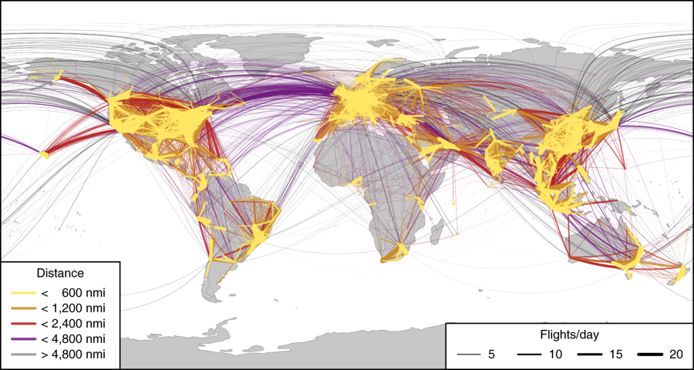

Hard to solve challenges
UCL Energy Institute: EnergySpaceTime group
Aviation
Carbon based fuel best– but where does the carbon come from in a low carbon world (tragic irony!)?
Kerosene synthesised from biomass, atmospheric CO2 capture and electrolytic hydrogen?
Some electric aviation…?
Technological, economic and environmental prospects of all-electric aircraft.
A Schaefer, 2018.
Dynamic system operation
Can autonomous competing agents deliver stable, minimum cost, equitable system operation?
How dumb is smart?
Do we need a Global Optimal Dispatcher (GOD)?

Slide 72
ESTIMO – illustrative results
UCL Energy Institute: EnergySpaceTime group
NB: The results are to illustrate some of the functionality of ESTIMO using different scenarios and meteorology. These are not related to the heat scenarios.
Flows in countries differ at any universal time (UTC: Coordinated Universal Time) because of different:
Local times and therefore activity
Service demands
Weather
Energy mix at consumer, intermediate and primary stages
Storage levels
International electricity trade

Slide 73
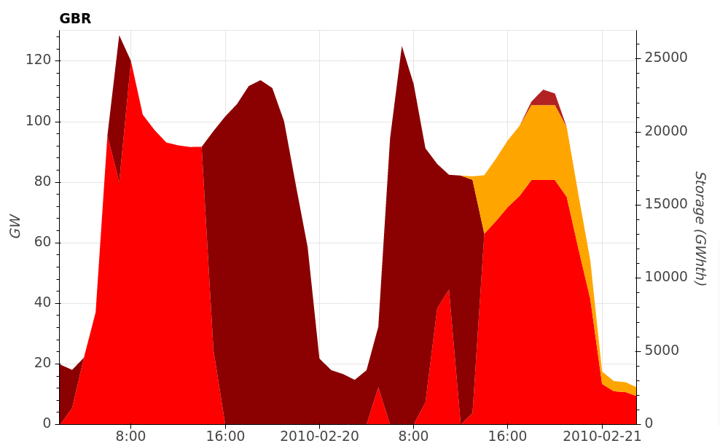
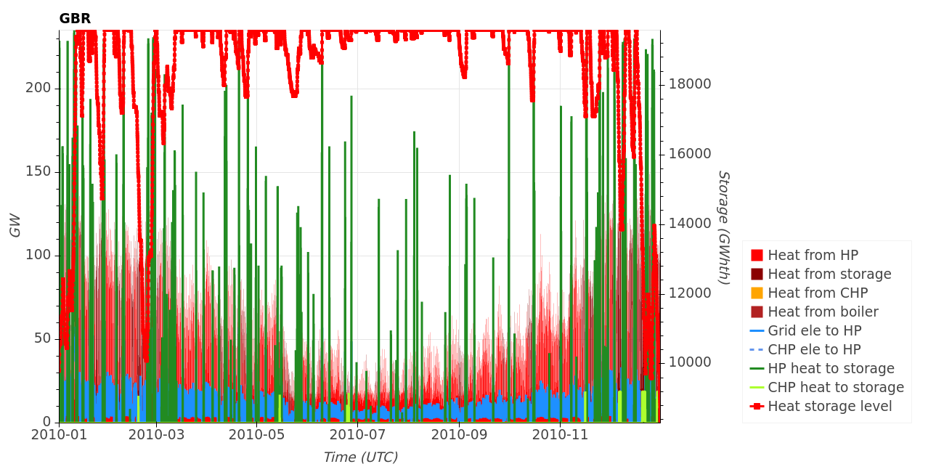
District heat supply in DH scenario – 2010 meteorology
UCL Energy Institute: EnergySpaceTime group
District heat can dynamically switch between:
Heat pumps - CHP - Boilers - Heat storage
and so help manage the wider energy system
UCL Energy Institute: EnergySpaceTime group
Notes:
Mark

Slide 74

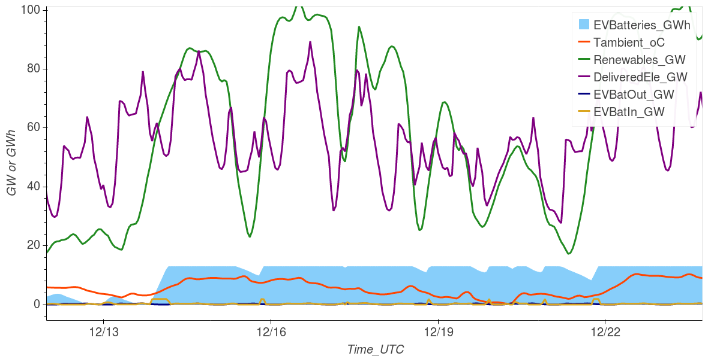

ESTIMO – weather impact on battery electric vehicles (2030)
UCL Energy Institute: EnergySpaceTime group
Typical weather (2004)
Vehicles are buildings on wheels and need heating and cooling like buildings, which affects their total demands and system efficiencies. ESTIMO includes a model of the effect of weather on EV demand.
In case of extreme weather events – like low winds and low temperatures – renewable generation could be low for several days and might not be able to meet electricity demand. The plots on the right show how social and weather patterns heavily influence a future UK energy system in 2030.
During the 10 days in December shown by the plots, in a typical winter weather (as in 2004), EV batteries were fully charged (light blue area). During extreme weather (as in 2010), EV batteries would be left almost empty for several days in a row.
Extreme weather (2010)
Notes:
74

Slide 75
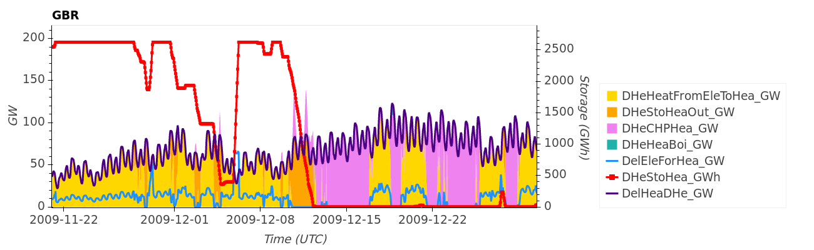
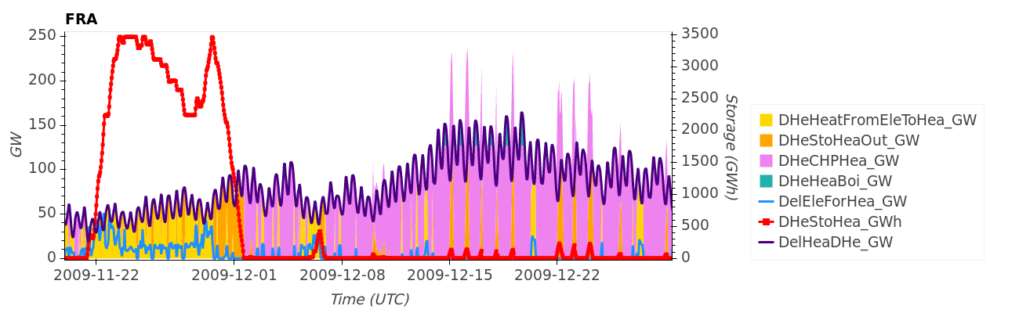
ESTIMO – district heating (hourly simulation for one month)
UCL Energy Institute: EnergySpaceTime group
Shows heat demand and heat pump, CHP, and boiler heat input varying with demand level and renewable surplus. District heat a valuable subsystem for managing larger system. Flows are different in GBR and FRA because of local time difference and weather.
Notes:
75

Slide 76
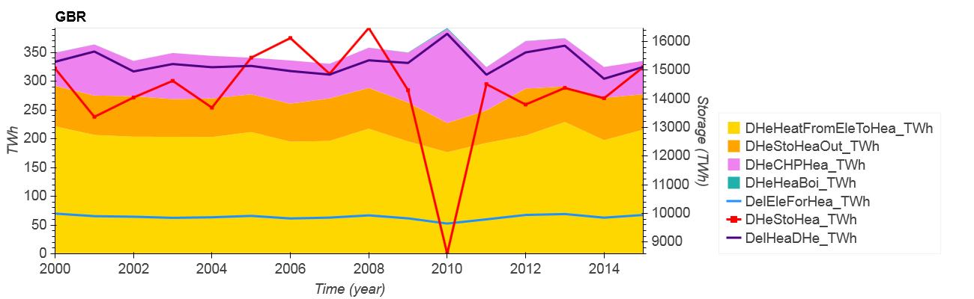
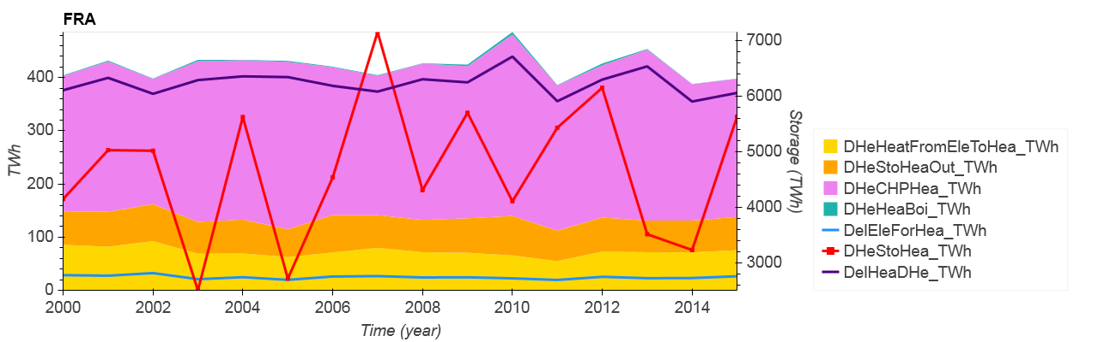
ESTIMO – district heating (annual sum)
UCL Energy Institute: EnergySpaceTime group
Demand and heat pump, CHP, boiler heat input varying with demand level and renewable surplus. District heat is a valuable subsystem for managing larger system. Flows are different in GBR and FRA because of weather.
Notes:
76

Slide 77
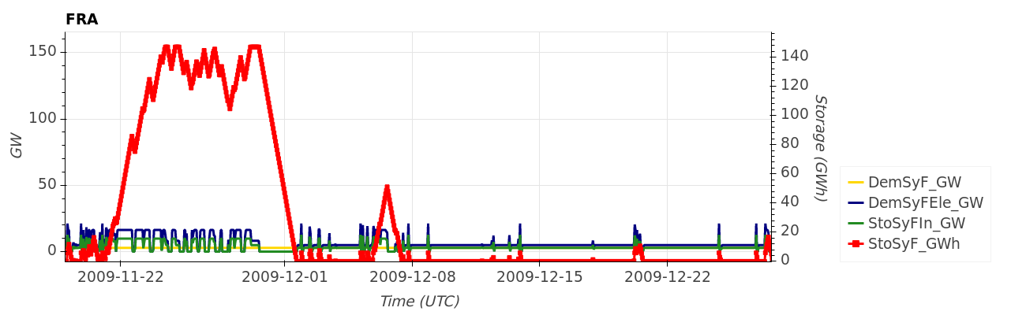
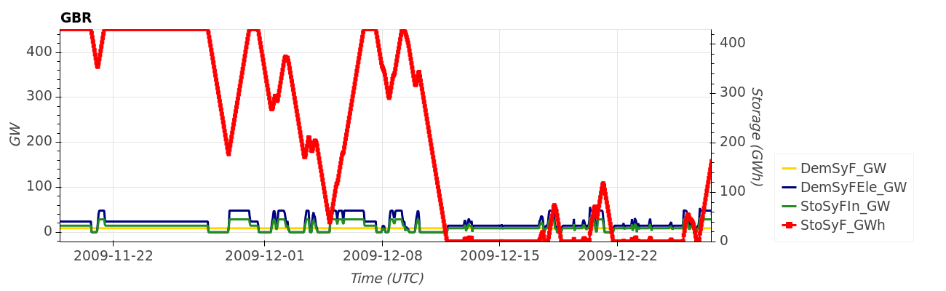
ESTIMO – electrofuels (hydrogen,ammonia) demand, production, storage
UCL Energy Institute: EnergySpaceTime group
Electrofuels are for powering ships, and dispatchable electricity and heat supply. Flows are different in GBR and FRA because of local time difference and weather.
Notes:
77

Slide 78
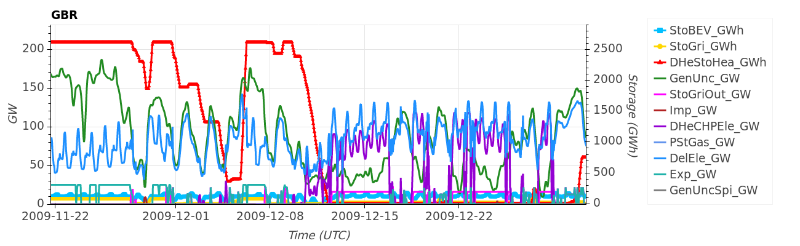
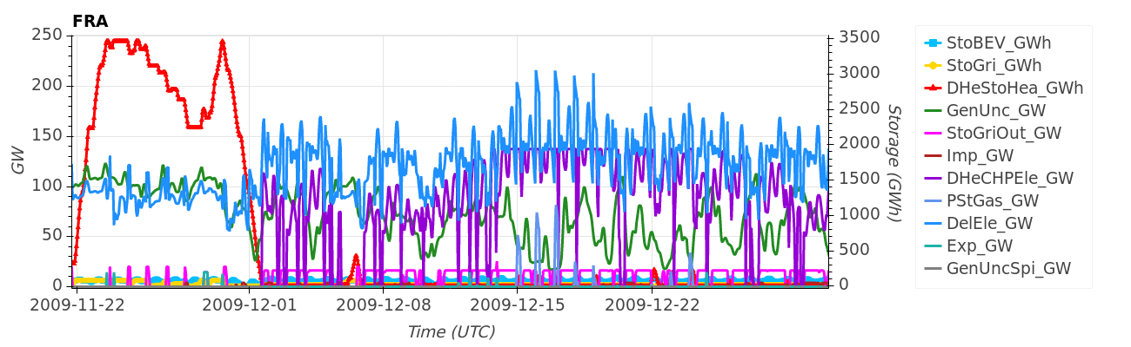
ESTIMO– electricity system integration (simulation hourly for one month)
UCL Energy Institute: EnergySpaceTime group
Demand, supply, storage, import/export flows are different in GBR and FRA because of local time difference and weather.
Notes:
78

Slide 79
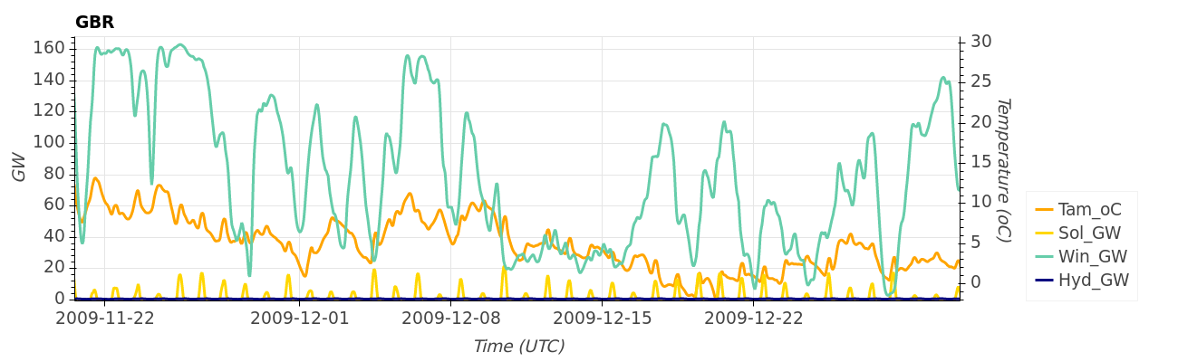
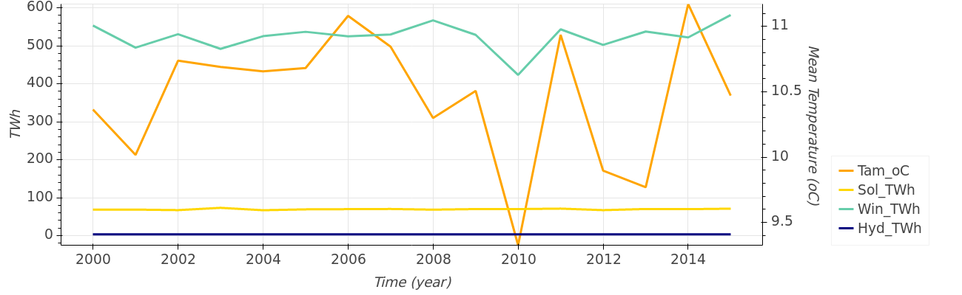
ESTIMO – weather and renewable generation
UCL Energy Institute: EnergySpaceTime group
Prolonged periods of high demand and low renewables stress the UK energy system determining minimum storage needs. E.g. 2010 is a stress year with a period that is cold, so high heat load, and also low wind.
Notes:
79

Slide 80
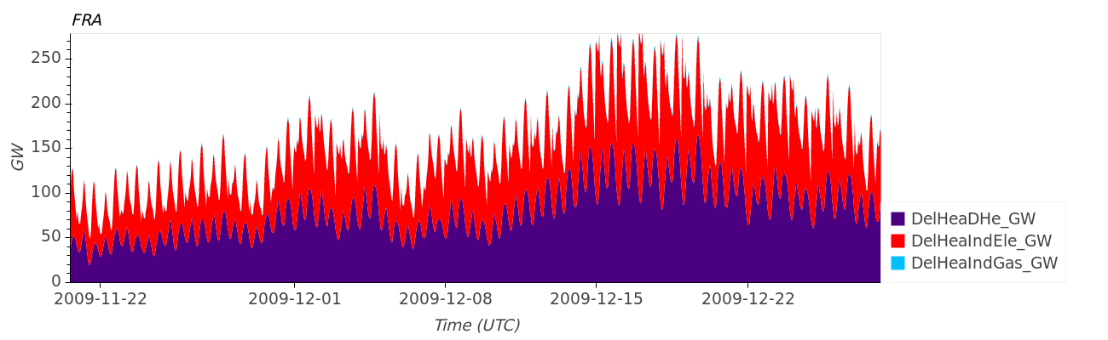
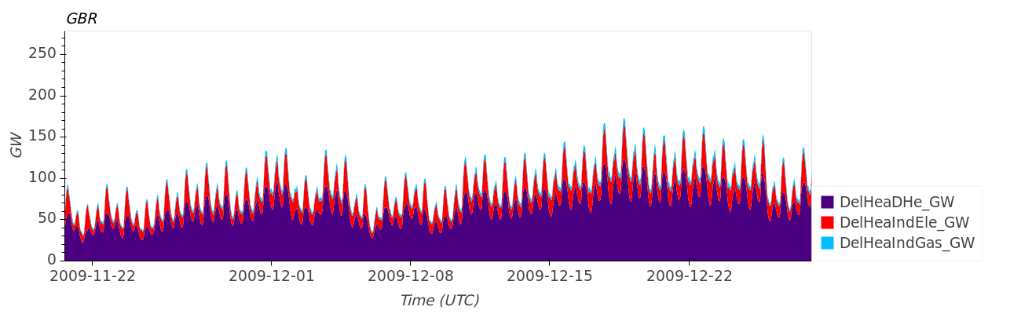
ESTIMO – heat supply
UCL Energy Institute: EnergySpaceTime group
Notes:
80

Slide 81
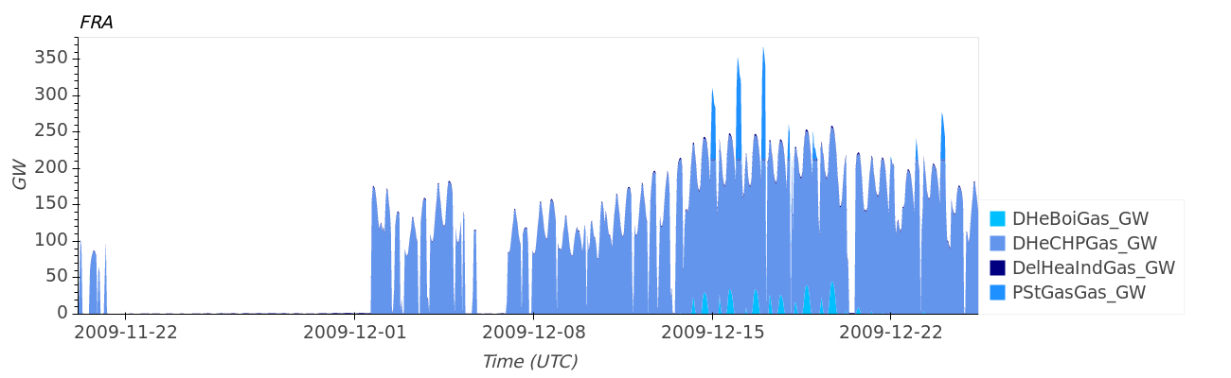
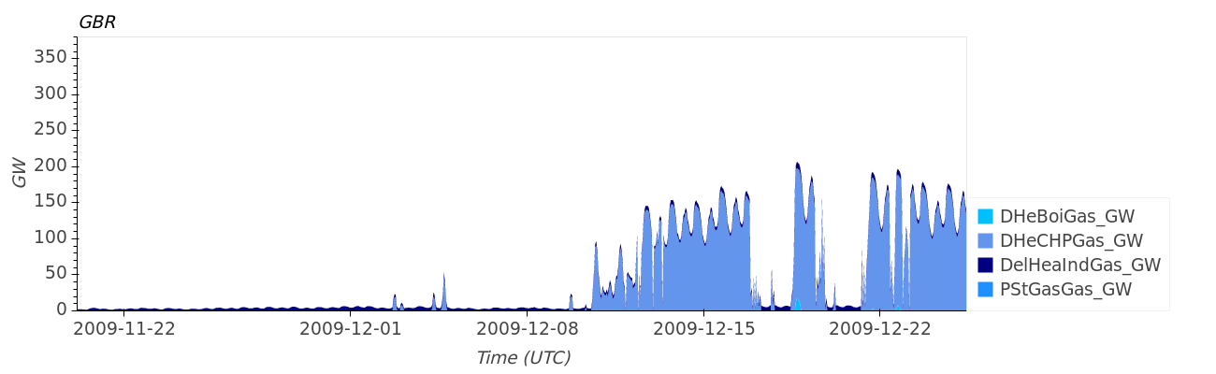
ESTIMO – gas
UCL Energy Institute: EnergySpaceTime group
Natural gas is used if no other energy is available and is used in DH CHP and boilers, and in electricity only generators (PstGas).
Notes:
81

Slide 82
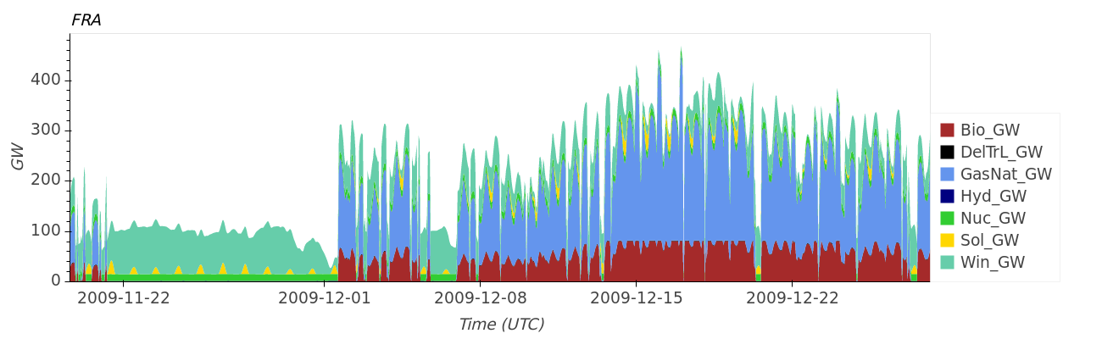
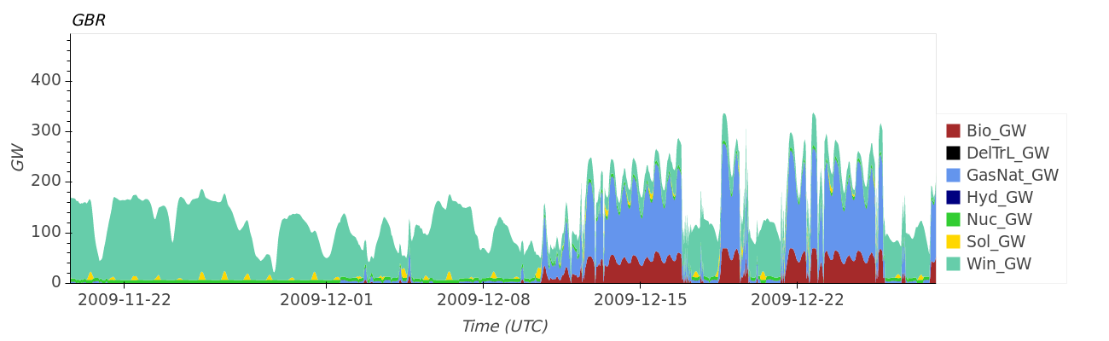
ESTIMO – primary energy
UCL Energy Institute: EnergySpaceTime group
When nuclear, renewables, input/output storage and trade are insufficient, the balance is made up using primary, one-way stores of chemical energy – biomass CHP, gas boiler and gas CCGT.
DelTrL: fossil liquid fuels (petrol, diesel etc.) for transport
Bio: generic biomass
Notes:
82

